Slide 1
City Council Meeting
October 9, 2017
Notes:
[Please adjust the text to be centered vertically if title and date create line breaks; turn on the static guides to help with placement.]

Slide 2
Item 7
Acceptance of bid for vacant commercial lot at 1119 West Fifth Street
Notes:
[Please adjust the text to be centered vertically after entering item description; turn on the static guides to help with placement.]

Slide 3
General Location Map
Notes:
The property is located in the south east portion of the city.

Slide 4
1119 W 5th Street
Council set fair market value for commercial lot on April 24, 2017 pursuant to NC General Statue 160A-268
Notice of Sale of Real Property in Daily Reflector and placed on City website on July 10, 2017 for 30 days
Offers due on August 10, 2017 at noon with a 5% deposit and proposed use of property

Slide 5
1119 W 5th Street
Marvin McKesson submitted only bid for the property for $9,600.00 with a 5% deposit of $480.00
Mr. McKesson proposed to put a coffee shop on this parcel

Slide 6
Aerial Map
(2016)
1119 W 5th St.
Notes:
The proposed use is located at 1909 E. Fire Tower Rd, Suite G. The subject property contains a 14,000 square foot office building with several units. The proposed unit is 1800 square feet with 1100 for retails sales such as video games, consoles, plush toys and collectible card games such as Magic The Gathering, and Pokemon. The remaining square footage of the unit is designated for the game center.

Slide 7
Item 8
Acceptance of bid for vacant commercial lot at 1404 West Fifth Street
Notes:
[Please adjust the text to be centered vertically after entering item description; turn on the static guides to help with placement.]

Slide 8
General Location Map
Notes:
The property is located in the south east portion of the city.

Slide 9
1404 W 5th Street
Council set fair market value for commercial lot on April 24, 2017 pursuant to NC General Statue 160A-268
Notice of Sale of Real Property in Daily Reflector and placed on City website on July 10, 2017 for 30 days
Offers due on August 10, 2017 at noon with a 5% deposit and proposed use of property

Slide 10
1404 W 5th Street
Marvin McKesson submitted only bid for the property for $19,800.00 with a 5% deposit of $990.00
Mr. McKesson proposed to put his cleaning business office space on this parcel

Slide 11
Aerial Map
(2016)
1404 W 5th St.
Notes:
The proposed use is located at 1909 E. Fire Tower Rd, Suite G. The subject property contains a 14,000 square foot office building with several units. The proposed unit is 1800 square feet with 1100 for retails sales such as video games, consoles, plush toys and collectible card games such as Magic The Gathering, and Pokemon. The remaining square footage of the unit is designated for the game center.

Slide 12
Item 9
Purchase of GRIDSMART Traffic Control Equipment: 2017 Resurfacing Project
Notes:
[Please adjust the text to be centered vertically after entering item description; turn on the static guides to help with placement.]

Slide 13
Overview
Why GRIDSMART
Performs stop-bar detection with single camera covering multiple approaches
Provides real-time data from multiple approaches with a single sensor / camera
Offers a virtual pan-tilt-zoom of the entire intersection, without movement of the camera, while maintaining all detection and data collection capabilities
Notes:
[Please adjust the text to be centered vertically after entering item description; turn on the static guides to help with placement.]

Slide 14
Overview
Why GRIDSMART
Offers a virtual pan-tilt-zoom of the entire intersection, without movement of the camera, while maintaining all detection and data collection capabilities
GRIDSMART designs and manufactures all elements of the GRIDSMART solution in the United States
Notes:
[Please adjust the text to be centered vertically after entering item description; turn on the static guides to help with placement.]

Slide 15
Overview
Why GRIDSMART
GRIDSMART’s tracking technology enables unique methods for mitigating issues created by shadows and occlusion (two issues commonly seen with other video solutions)
GRIDSMART is the only product available leveraging three-dimensional (3D) omni-directional tracking technology. This technology enables a single camera to track vehicles in a 360° radius from the camera, and provides data on the vehicles such as volume, turning movements, length-based classification
Notes:
[Please adjust the text to be centered vertically after entering item description; turn on the static guides to help with placement.]

Slide 16
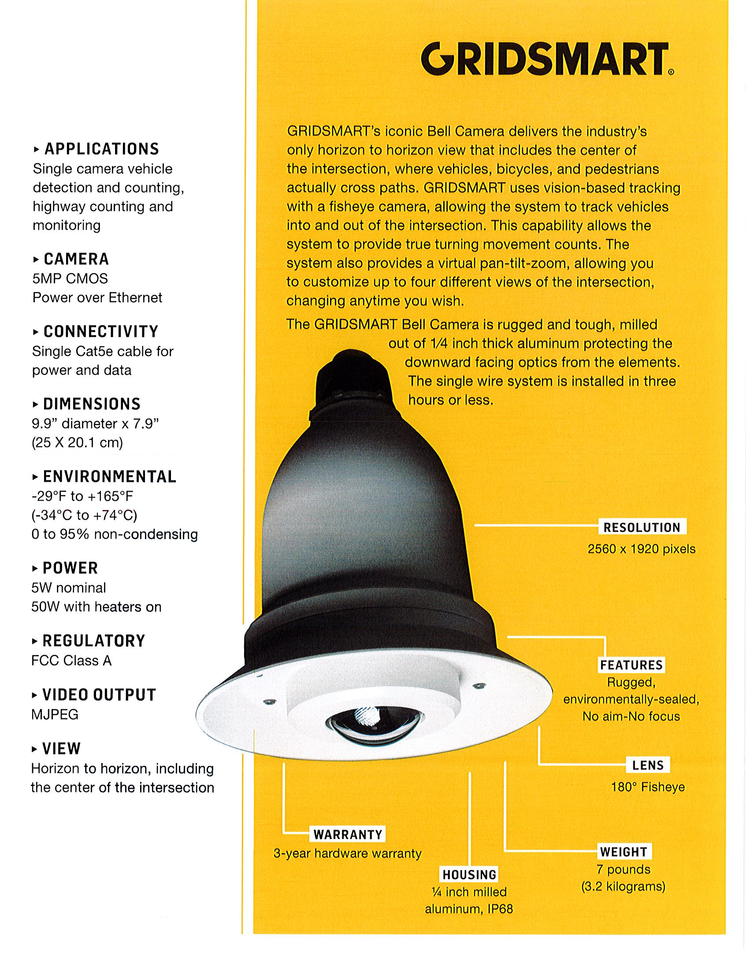
Equipment:
3-D omni-directional tracking technology
Notes:
[Please adjust the text to be centered vertically after entering item description; turn on the static guides to help with placement.]

Slide 17
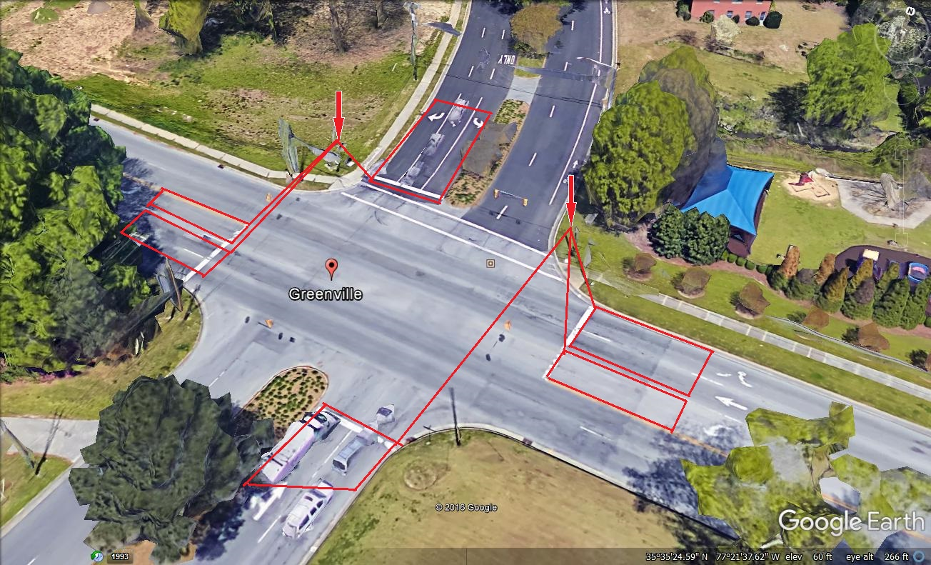
Pilot Installation
Greenville & Elm
Notes:
[Please adjust the text to be centered vertically after entering item description; turn on the static guides to help with placement.]

Slide 18
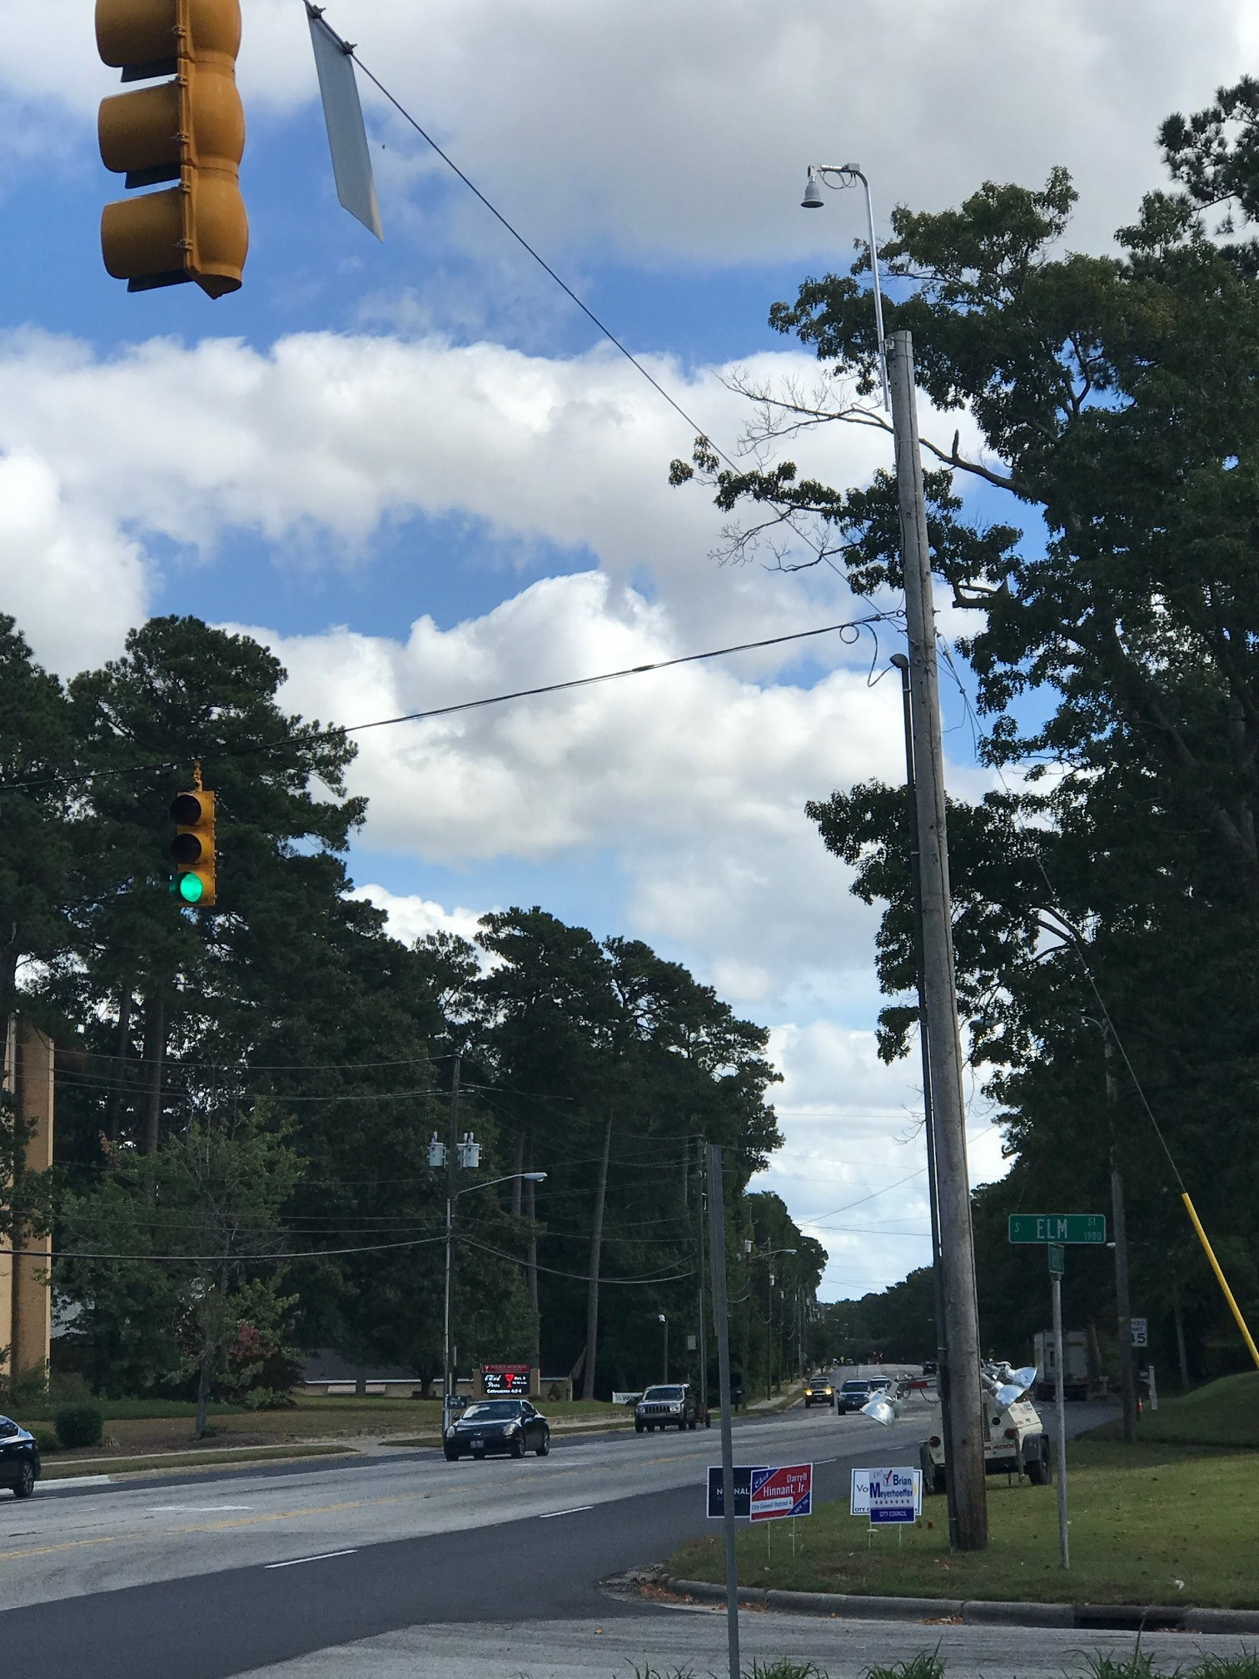
Equipment Installed
Notes:
[Please adjust the text to be centered vertically after entering item description; turn on the static guides to help with placement.]

Slide 19
2017 Resurfacing Projects
13 locations:
1st St. / Elm St.
4th St. / Elm St.
5th St. / Elm St.
10th St. / Elm St.
14th St. / Elm St.
Hooker Rd. / Arlington Blvd.
Memorial Dr. / Mall Dr.
Notes:
[Please adjust the text to be centered vertically after entering item description; turn on the static guides to help with placement.]

Slide 20
2017 Resurfacing Projects
Locations continued:
Greenville Blvd. / Hooker Rd.
Memorial Drive / Arlington Blvd.
Greenville Blvd. / Mall Dr.
Memorial Dr. / Country Club Dr.
10th St. / Oxford Rd.
Greenville Blvd. / Eastbrook Dr.
Notes:
[Please adjust the text to be centered vertically after entering item description; turn on the static guides to help with placement.]

Slide 21
Schedule
Approval
Ordering process: 1 week
Receive materials: 30 days
Installation: 4 – 6 weeks
Notes:
[Please adjust the text to be centered vertically after entering item description; turn on the static guides to help with placement.]

Slide 22
Item 12:
Presentations by Boards and Commissions
A) Greenville Bicycle and Pedestrian Commission
Notes:
[Please adjust the text to be centered vertically if title and date create line breaks; turn on the static guides to help with placement.]

Slide 23
Restructuring:
The Bicycle and Pedestrian Commission (BAPC) had had quorum since restructuring. BAPC is currently waiting to fill our recently vacated 9th seat from the existing candidate bank.
Notes:
[Please adjust the text to be centered vertically after entering item description; turn on the static guides to help with placement.]

Slide 24
National Bike Month Events (May 2017):
Worked with EC Velo to host Bike Fiesta and a Ride of Silence
Promoted National Bike Month via social media and Greenville TV.
Taught the League of American Bicyclist’s Smart Cycling Course.
Mayor proclamation to declare May as Bike Month
BAPC hosted a ride along Greenway and 5th Street
Notes:
[Please adjust the text to be centered vertically after entering item description; turn on the static guides to help with placement.]

Slide 25
More Activities:
NC APA Bike Tour
Continue advocacy for the addition of more sidewalks
Resolution to support complete streets ordinance on all NC DOT projects
Notes:
[Please adjust the text to be centered vertically after entering item description; turn on the static guides to help with placement.]

Slide 26
BAPC Members served on advisory committees for several Greenville planning processes in 2017:
Evans Street Widening Project
Active Transportation Master Plan
10th Street Corridor Improvements
Notes:
[Please adjust the text to be centered vertically after entering item description; turn on the static guides to help with placement.]

Slide 27
2017 Bike/Ped Counts:
For the sixth year running, BAPC members carried out manual bike and pedestrian counts as part of the National Bicycle and Pedestrian Documentation Process.
5th and Evans: 26 cyclists and 576 pedestrians
Greenway: 85 cyclists and 284 pedestrians
Notes:
[Please adjust the text to be centered vertically after entering item description; turn on the static guides to help with placement.]

Slide 28
Plans for 2018:
Sidewalk Ordinance
Update the City Bike Map
Assist in implementing and promoting ATMP
Support and promote the GTAC and Action Sports Complex
Promote new Greenway extensions as well as bicycle and pedestrian safety in general
Notes:
[Please adjust the text to be centered vertically after entering item description; turn on the static guides to help with placement.]

Slide 29
2018 Plans (cont’d):
Create a robust partnership between NCDOT, the MPO, City Council and the County to stay abreast and be a strategic partner in the road projects in and around Greenville. For example, Allen Road, Fire Tower Road, 14th Street, etc.
Develop a “Greenville Walks” program sponsored by City Council in conjunction with Rec & Parks and various stakeholders in the community. These monthly walks could be rotated throughout the City with each Council Member walking with their constituents.
Notes:
[Please adjust the text to be centered vertically after entering item description; turn on the static guides to help with placement.]

Slide 30
Thank you!
Notes:
[Please adjust the text to be centered vertically after entering text; turn on the static guides to help with placement.]

Slide 31
Item 12:
Presentations by Boards and Commissions
B) Investment Advisory Committee
Notes:
[Please adjust the text to be centered vertically if title and date create line breaks; turn on the static guides to help with placement.]

Slide 32
Purpose
Provide additional oversight
Review investment results
Advise the staff Investment Committee
Report any occurrences that conflict with Policy
Established August 7, 2006

Slide 33
Committees
  Investment Advisory Committee
Scott Below – Chairman
Cameron Evans – Vice Chair
Cameron Lovitt – Secretary
City Council Liaison
PJ Connelly, City Council Member
Investment Committee
Ann Wall – City Manager
Michael Cowin – Assistant City Manager
Bernita Demery – Director of Financial Services
Jacob Joyner – Financial Services Manager

Slide 34
Restrict Invest.
N.C.General Statute 159.30
Credit Risks
Some Agencies and Treasuries
Investment Policy
Safety, Liquidity, Yield
Diversity
Security
Econ.
Environ.
Investment Considerations

Slide 35
Objectives
SYSTEMATIC APPROACH
VOID OF SPECULATION
MAXIMIZE EARNINGS
PERFORMANCE EVALUATION

Slide 36
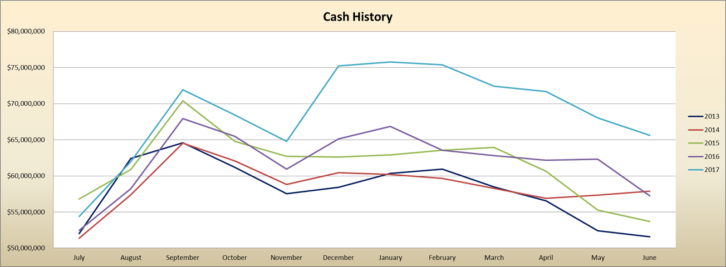
Five Year Cash Balance History

Slide 37
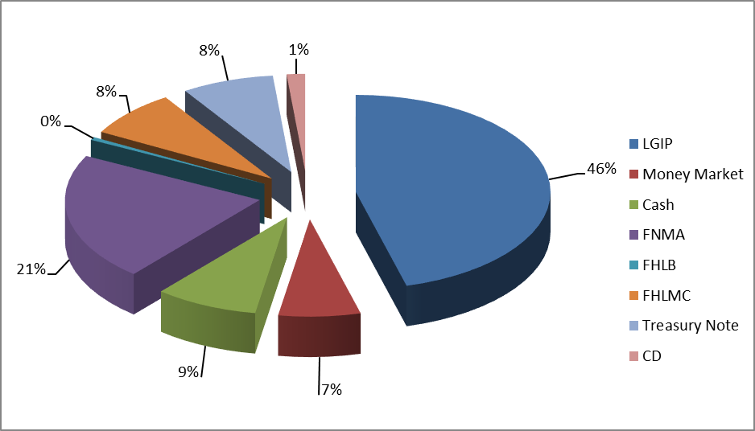
Portfolio Allocation

Slide 38
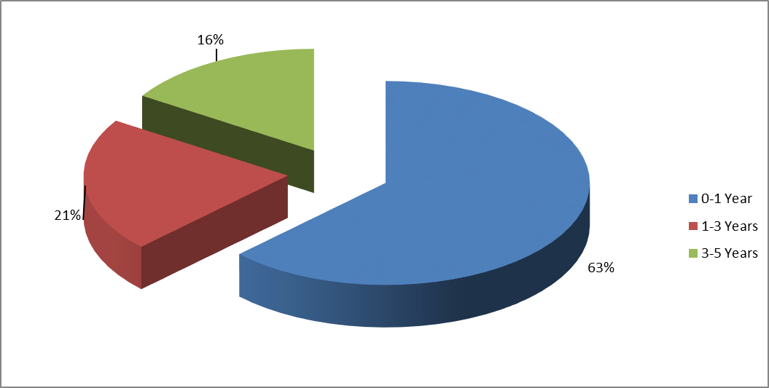
Portfolio by Maturity

Slide 39
City of Greenville Rate Comparison
Investment Portfolio Update
 | June 30, 2017 | June 30, 2016
Market | $ 65.8 M | $ 57.9 M
YTM Return @ Cost | .92 % | .68%

Slide 40
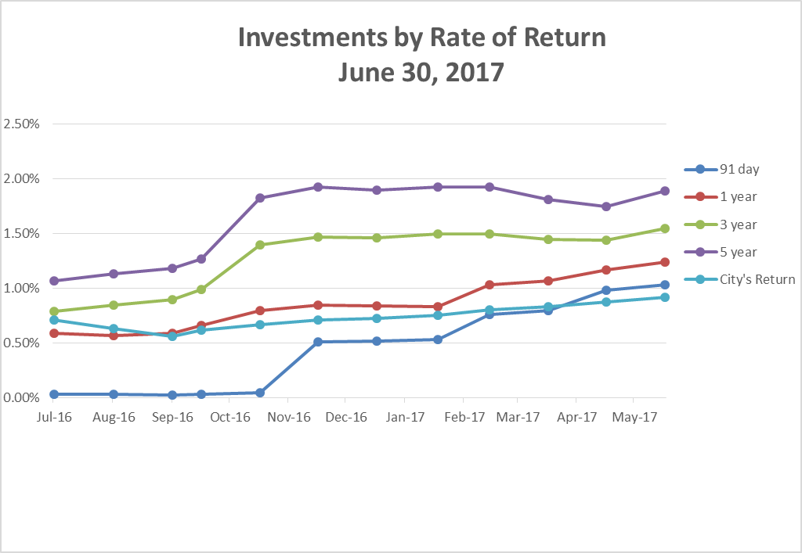
City of Greenville Yield Quarterly Treasury Rate Comparisons

Slide 41
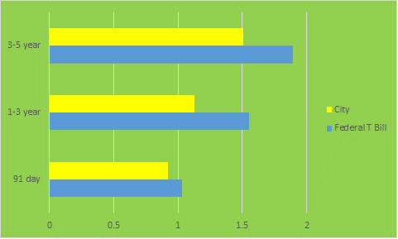
City of Greenville YTM Comparison

Slide 42
Accomplishments
  Maintained a diverse Portfolio
  Transitioned long term investments into shorter terms
  Managed the investment of Bond proceeds
  Diversified our investment partners to include SunTrust Bank

Slide 43
Considerations for 2018
Continued diversification within restrictions
Continued attention to yield while maintaining liquidity and safety
Update Investment Policy

Slide 44
Questions

Slide 45
Item 13:
Municipal Agreement with the North Carolina Department of Transportation for a Citywide Traffic Signal System Upgrade
Notes:
[Please adjust the text to be centered vertically if title and date create line breaks; turn on the static guides to help with placement.]

Slide 46
Overview
Project to upgrade combined City/State Traffic Signal System
Upgrade and replacement of critical components of the system
Utilizing latest technology at the time of design
Ensuring future statewide compatibility of equipment for on-going maintenance
Notes:
[Please adjust the text to be centered vertically after entering item description; turn on the static guides to help with placement.]

Slide 47
Current System
Combined City/State system:
127 NCDOT signals
32 COG signals
Traffic Control Center (Public Works)
City Traffic Division maintains all signals
Notes:
[Please adjust the text to be centered vertically after entering item description; turn on the static guides to help with placement.]

Slide 48
Project Intent
Replacement/upgrade of critical system components:
New traffic controllers
New cabinets (for controllers)
New fiber-optic network
Upgraded vehicle detection systems at select intersections
Upgraded equipment for the Traffic Control Center
Notes:
[Please adjust the text to be centered vertically after entering item description; turn on the static guides to help with placement.]

Slide 49
Funding
Project estimated at $9.795 million, collectively financed as follows:
Federal: 80% of total project
State and City: 20% local contribution
State split 79% of local 20%
City split 21% of local 20%
Notes:
[Please adjust the text to be centered vertically after entering item description; turn on the static guides to help with placement.]

Slide 50
Funding Details
Fund Source | Amount | State Match | Local Match
Federal (80%) | $7,418,080
State (79% of 20%) |  | $1,465,071
Local (21% of 20%) |  |  | $389,449
8 Non-eligible City Locations (100%) |  |  | $522,400
Subtotals | $7,418,080 | $1,465,071 | $911,849
Total Estimated Cost: $9,795,000
Notes:
[Please adjust the text to be centered vertically after entering item description; turn on the static guides to help with placement.]

Slide 51
City Fiscal Responsibility
City funding:
$911,849
Reflects proportion of project signal ownership between State and City (21% of 20% local match)
City responsibility of payment is due upon completion of project
Milestone is estimated to be 5 years from now
Notes:
[Please adjust the text to be centered vertically after entering item description; turn on the static guides to help with placement.]

Slide 52
Recommendation
City Council approve the Municipal Agreement between NCDOT and the City of Greenville for the implementation of the traffic signal upgrade
Notes:
[Please adjust the text to be centered vertically after entering item description; turn on the static guides to help with placement.]

Slide 53
Item 14:
Contract award for the FY 2018 Stormwater Pipe Repair Project
Notes:
[Please adjust the text to be centered vertically if title and date create line breaks; turn on the static guides to help with placement.]

Slide 54
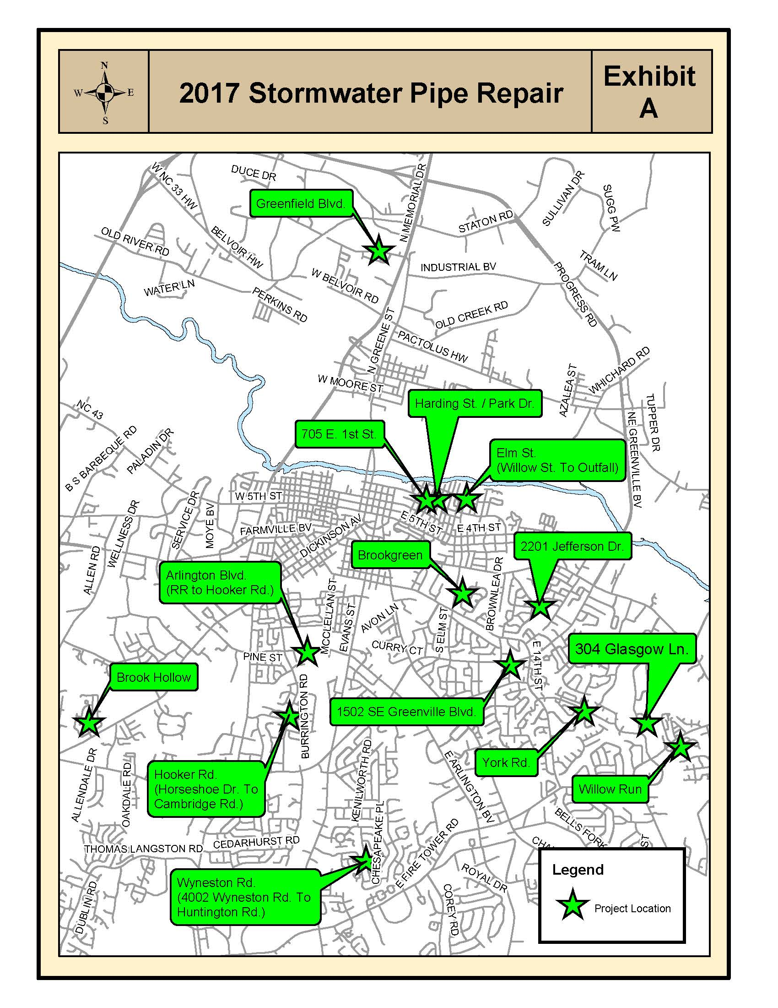
Overview Map
Notes:
[Please adjust the text to be centered vertically after entering text; turn on the static guides to help with placement.]

Slide 55
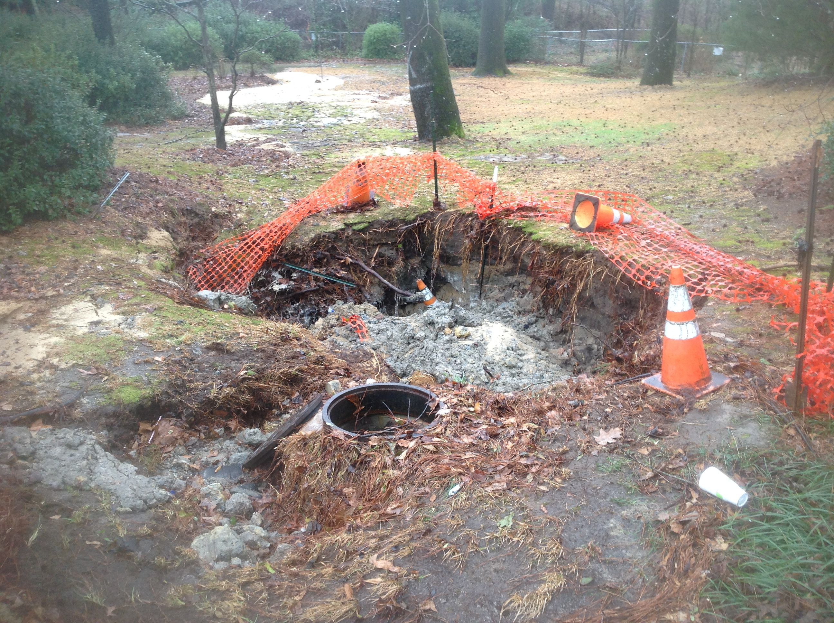
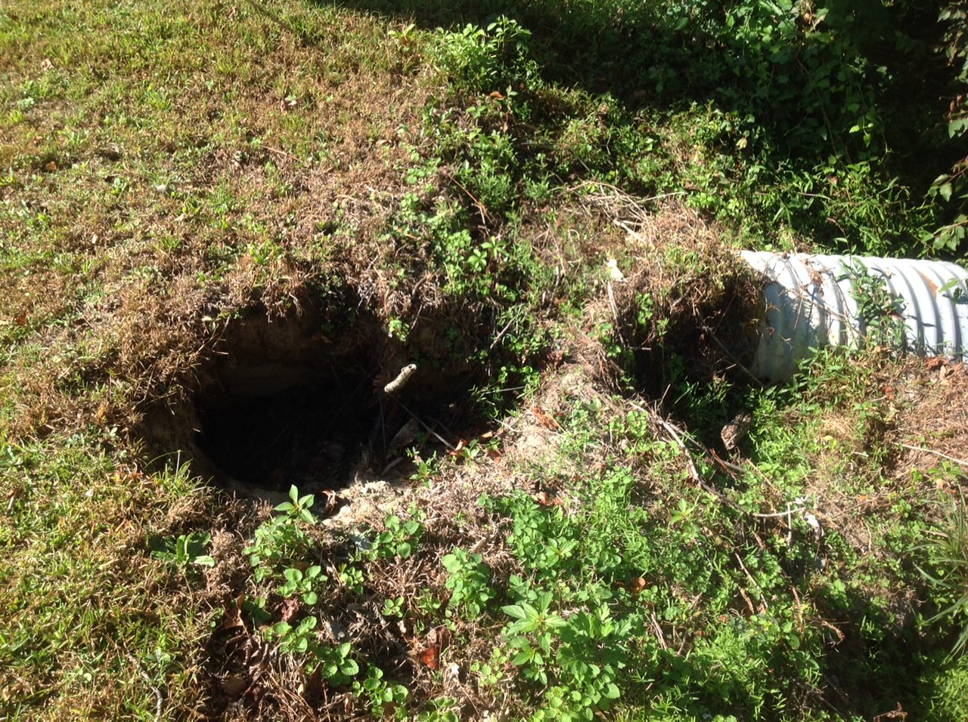
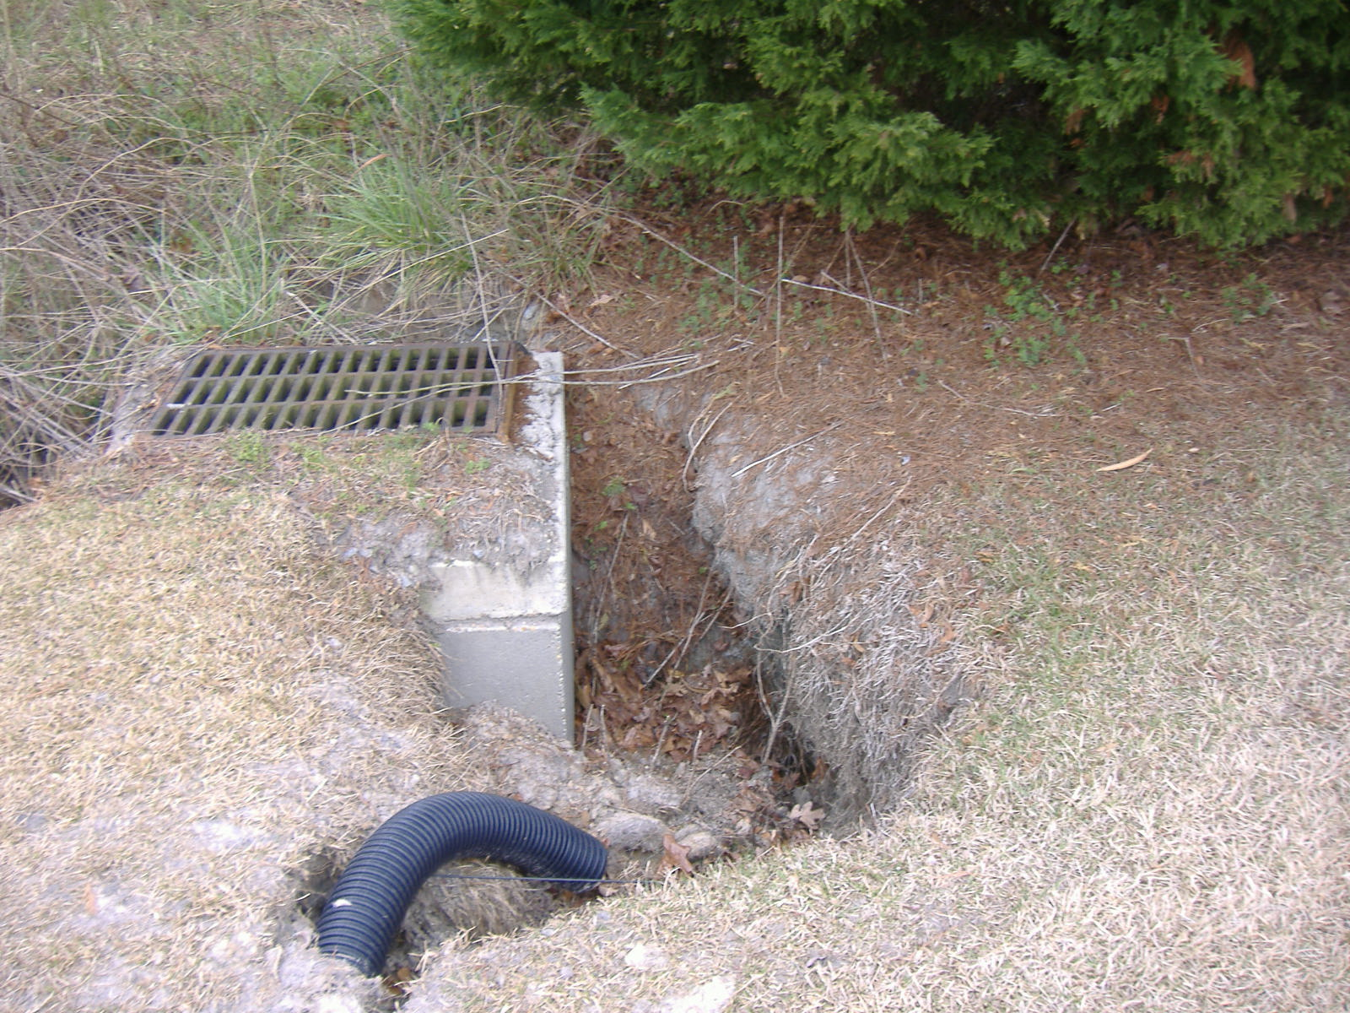
Typical Condition
Notes:
[Please adjust the text to be centered vertically after entering item description; turn on the static guides to help with placement.]

Slide 56
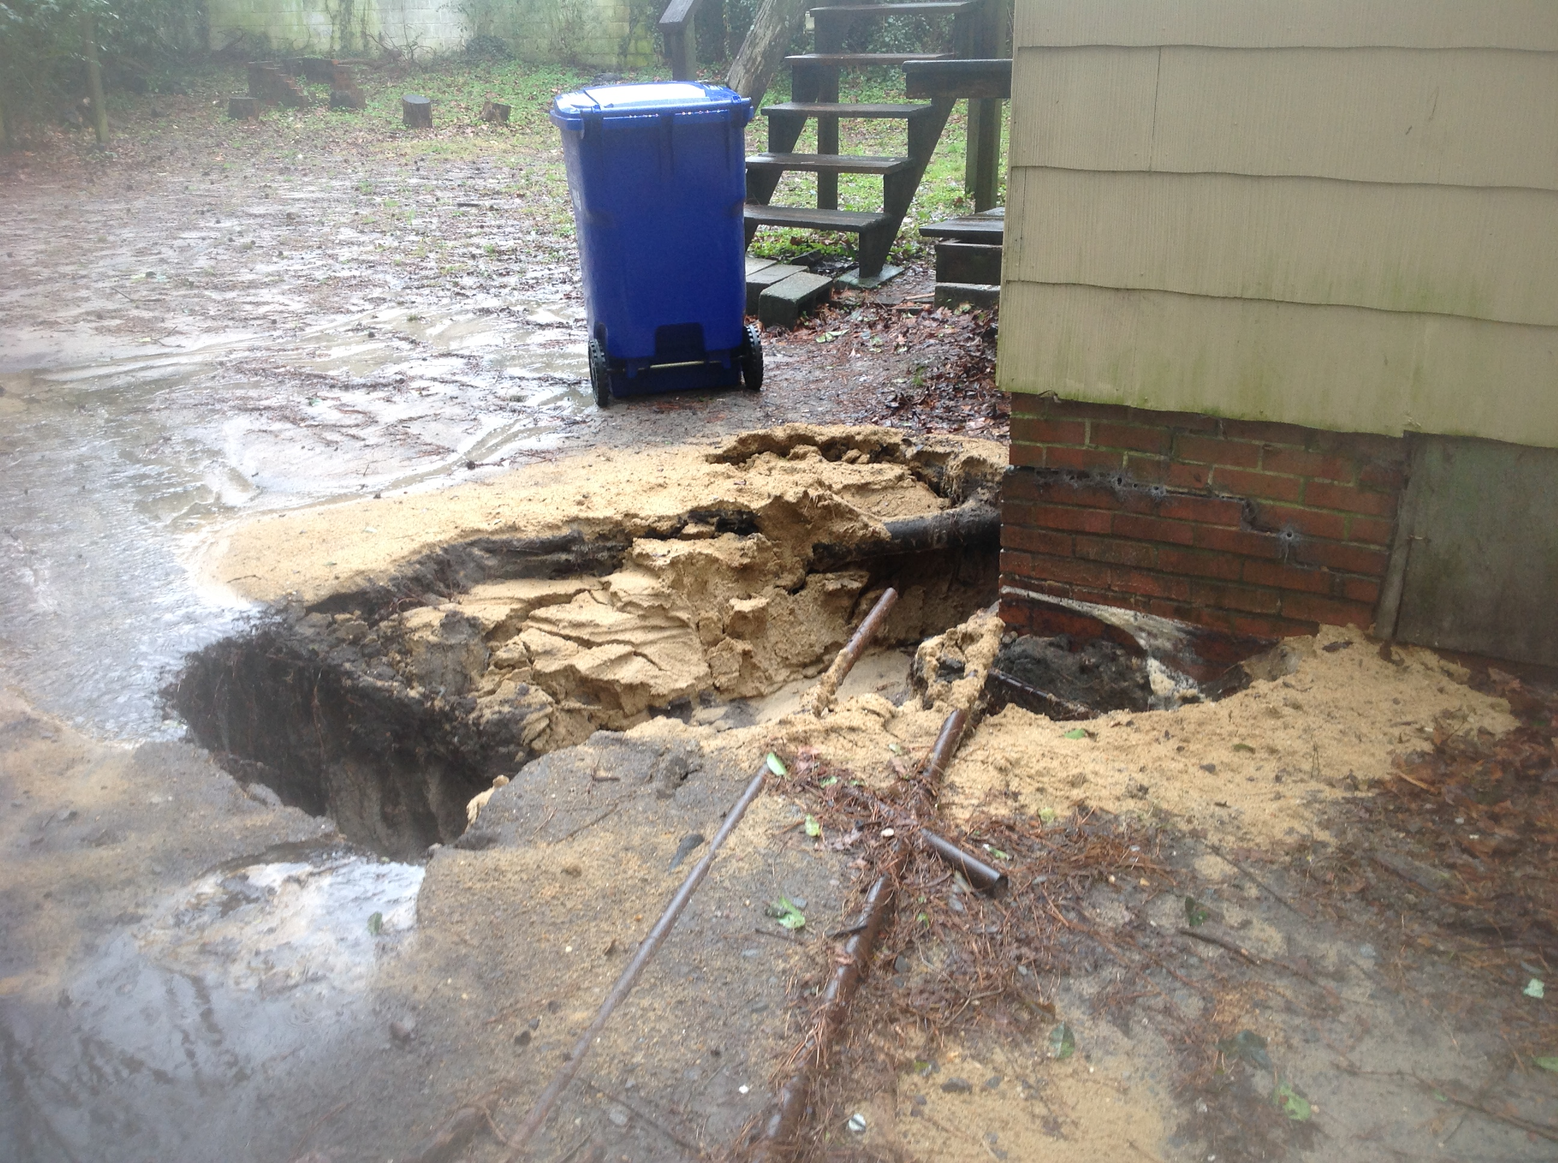
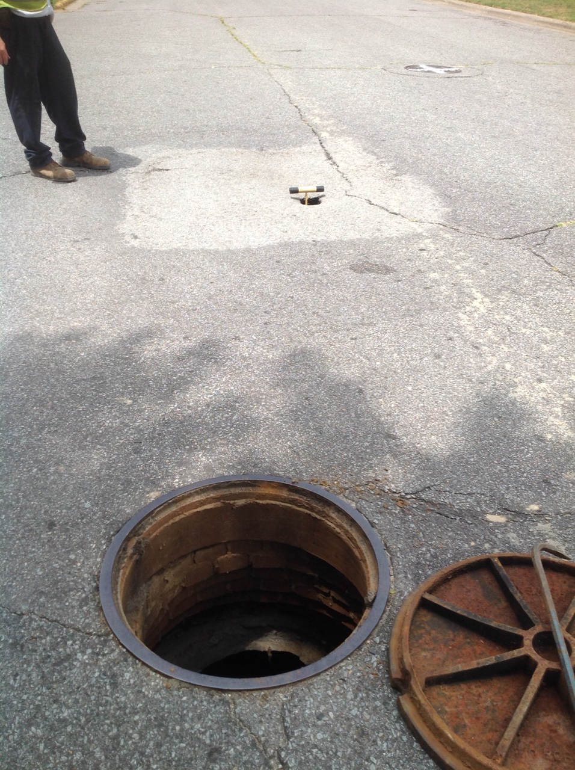
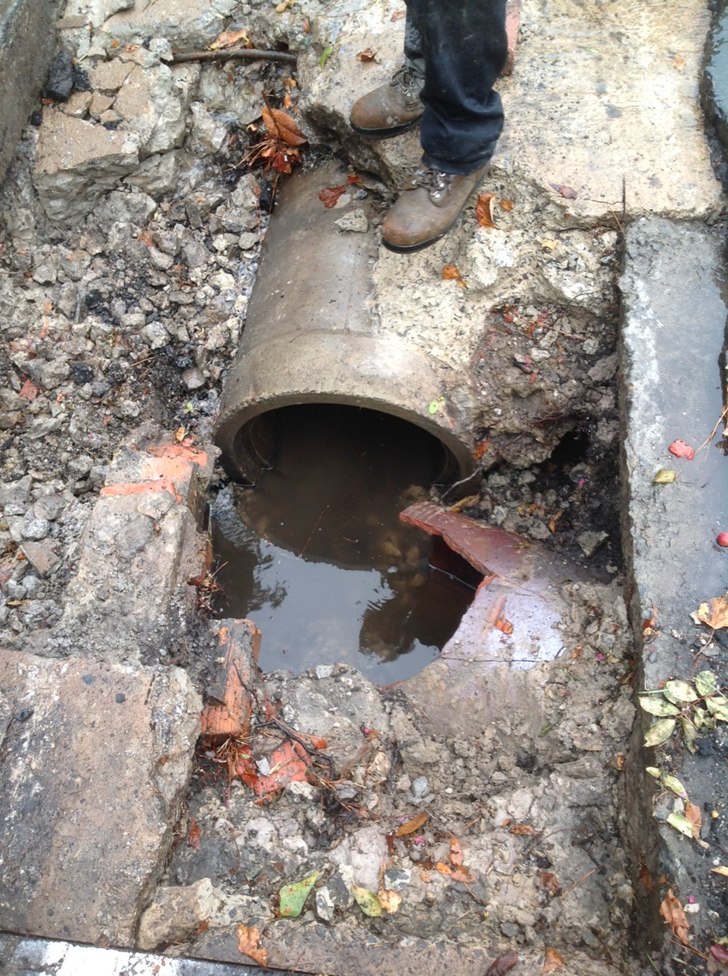
Typical Condition
Notes:
[Please adjust the text to be centered vertically after entering item description; turn on the static guides to help with placement.]

Slide 57
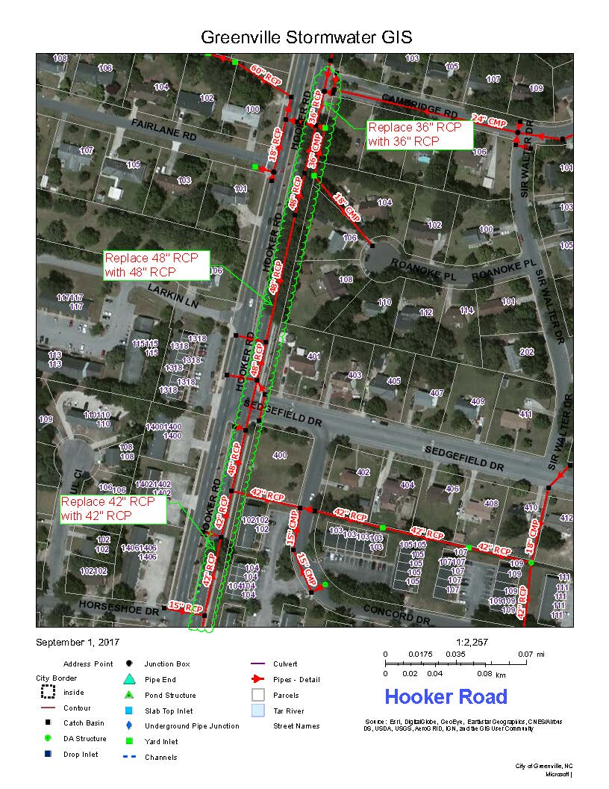
Hooker Road
Replace 1150’ of RCP in kind
City ROW
Joint separation
Notes:
[Please adjust the text to be centered vertically after entering item description; turn on the static guides to help with placement.]

Slide 58
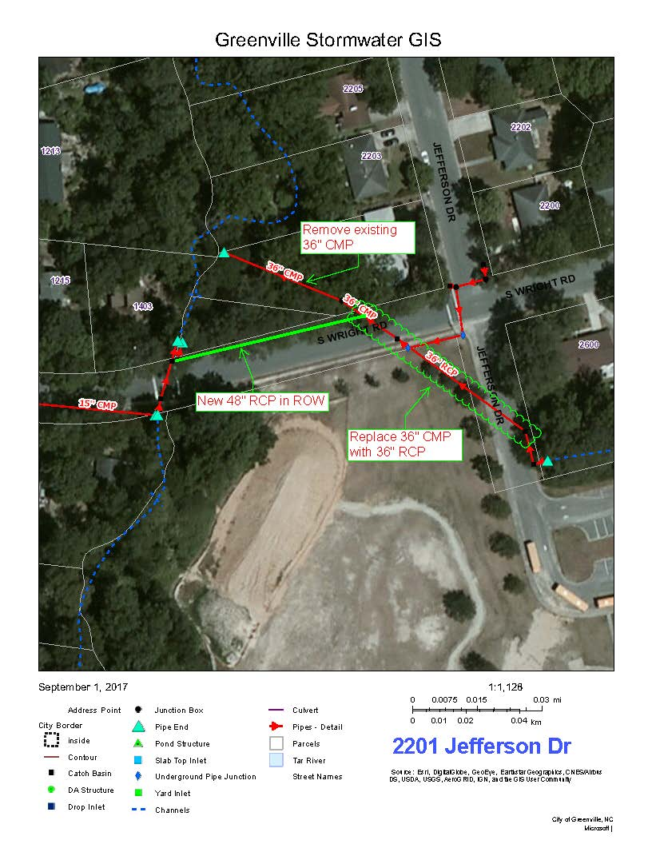
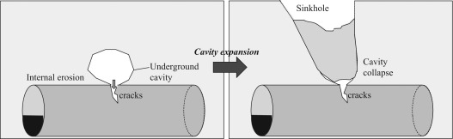
2201 Jefferson Drive
Relocate from private property to City ROW
Joint separation and box failing
Notes:
[Please adjust the text to be centered vertically after entering item description; turn on the static guides to help with placement.]

Slide 59
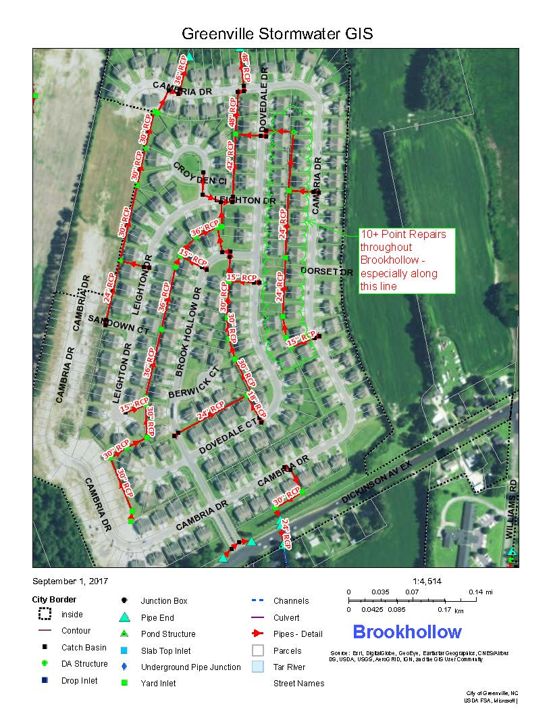
Brook Hollow
Joint Repair
SW pipe initially installed ~2007
Joint separation and settlement
Notes:
[Please adjust the text to be centered vertically after entering item description; turn on the static guides to help with placement.]

Slide 60
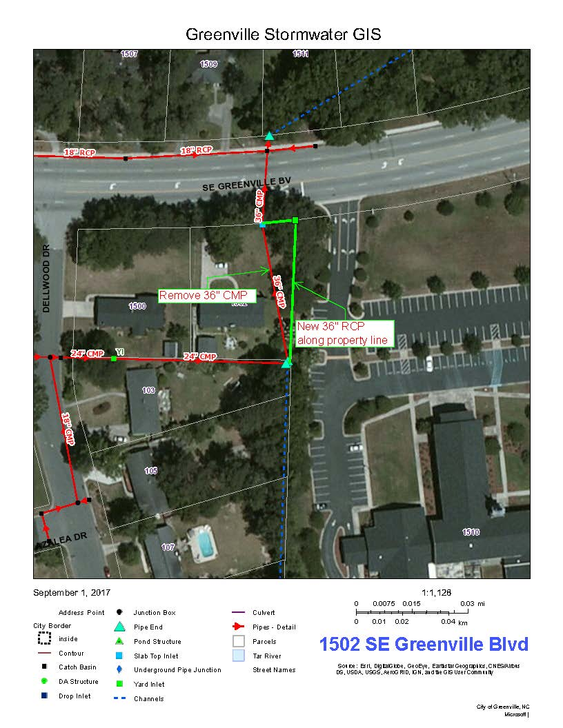
1502 SE Greenville Blvd
Adjacent to home foundation
Relocate to private property line
Bottom of pipe is rusted out
Notes:
[Please adjust the text to be centered vertically after entering item description; turn on the static guides to help with placement.]

Slide 61
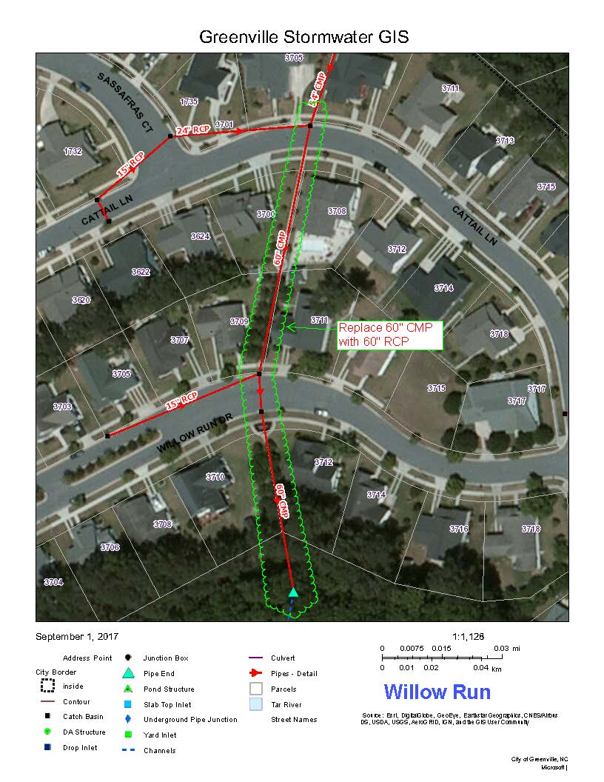
Willow Run
Replace 60’ CMP with RCP in kind
Private property and City ROW
Joint separation
Pipe – 20yrs old
Notes:
[Please adjust the text to be centered vertically after entering item description; turn on the static guides to help with placement.]

Slide 62
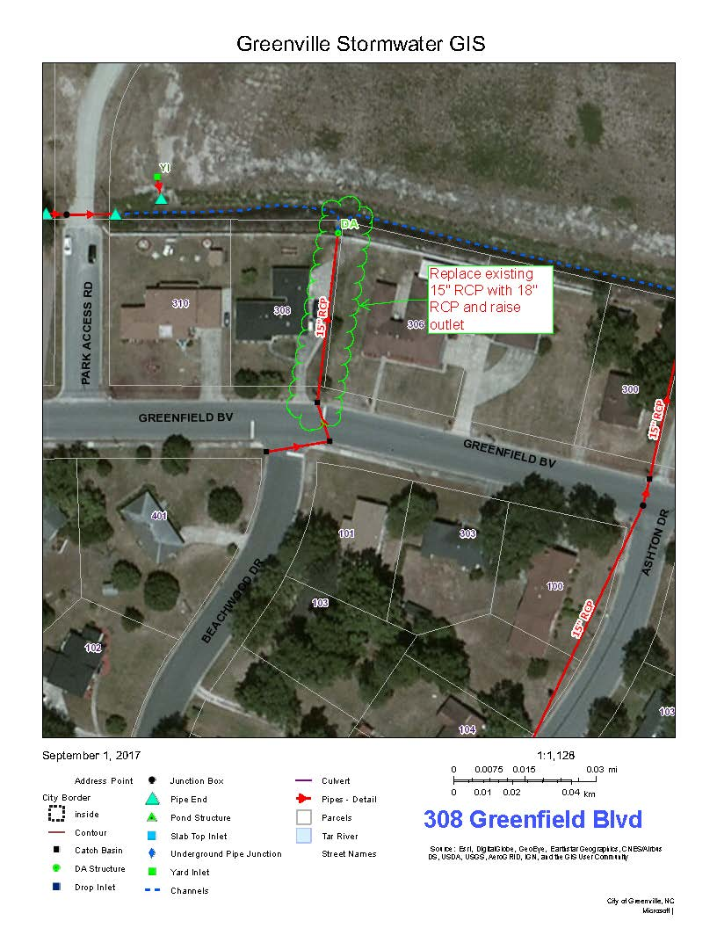
308 Greenfield Blvd
Upsize system and raise outlet
Private property
Pipe rusted out
Notes:
[Please adjust the text to be centered vertically after entering item description; turn on the static guides to help with placement.]

Slide 63
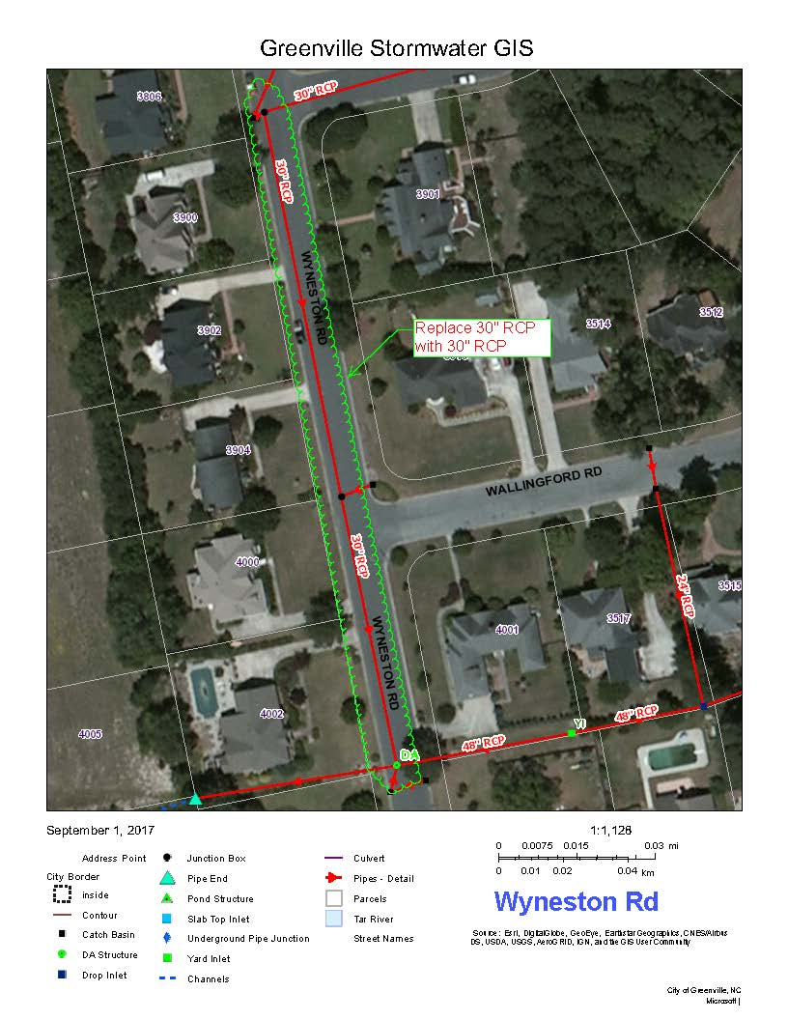
Wyneston Road
Replace pipe with 30-inch RCP
City ROW
Joint separation
Pipe is 20+ yrs old
Notes:
[Please adjust the text to be centered vertically after entering item description; turn on the static guides to help with placement.]

Slide 64
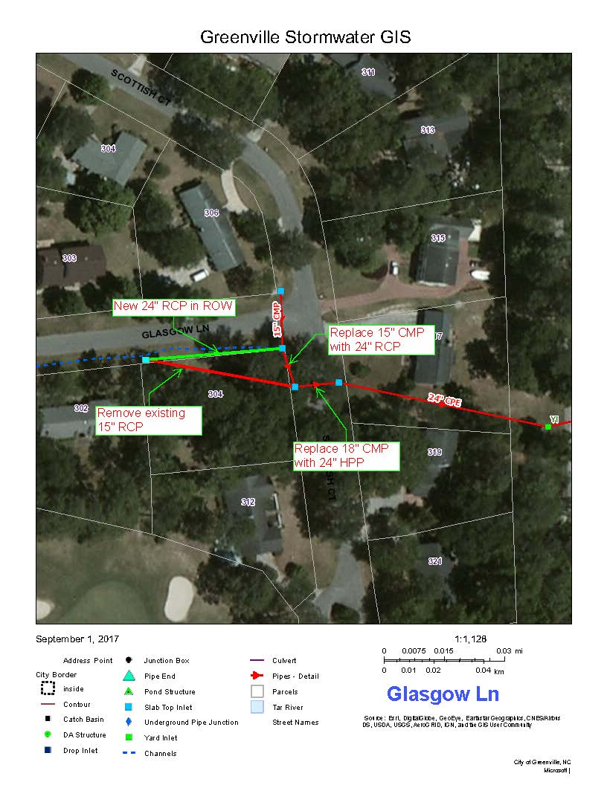
Glasgow Lane
Relocate: under accessory structure on private property to City ROW
Joint separation and box failure
Notes:
[Please adjust the text to be centered vertically after entering item description; turn on the static guides to help with placement.]

Slide 65
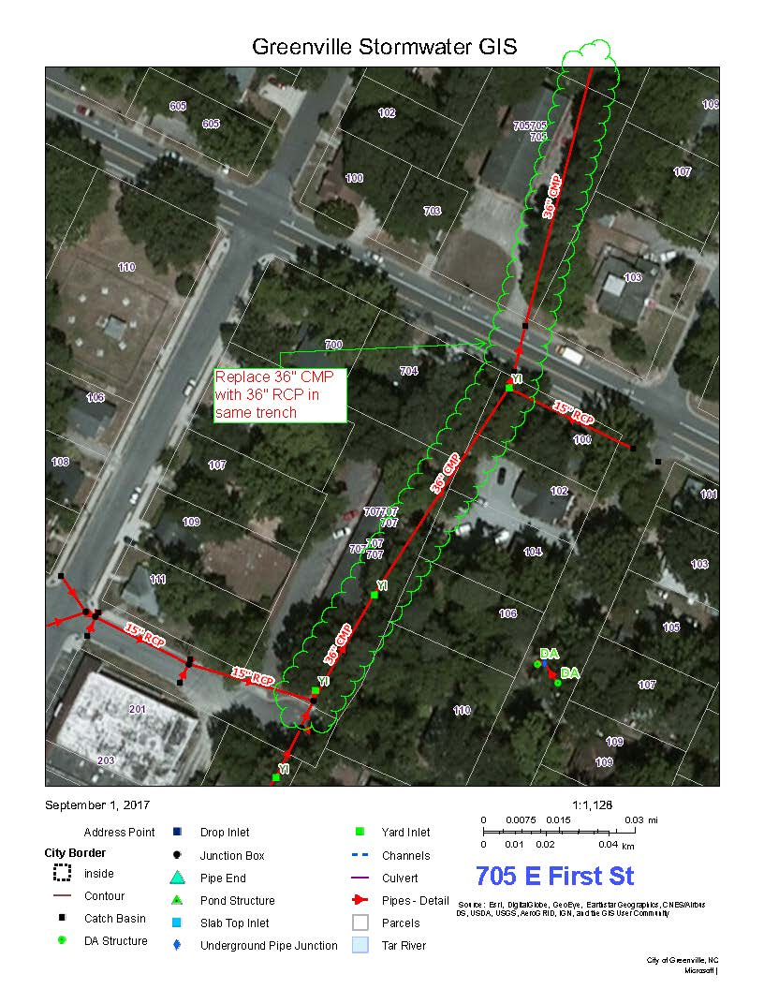
705 E First Street
Replace 575’ CMP with RCP in kind
Private Property and City ROW
Bottom of pipe is rusted out
Notes:
[Please adjust the text to be centered vertically after entering item description; turn on the static guides to help with placement.]

Slide 66
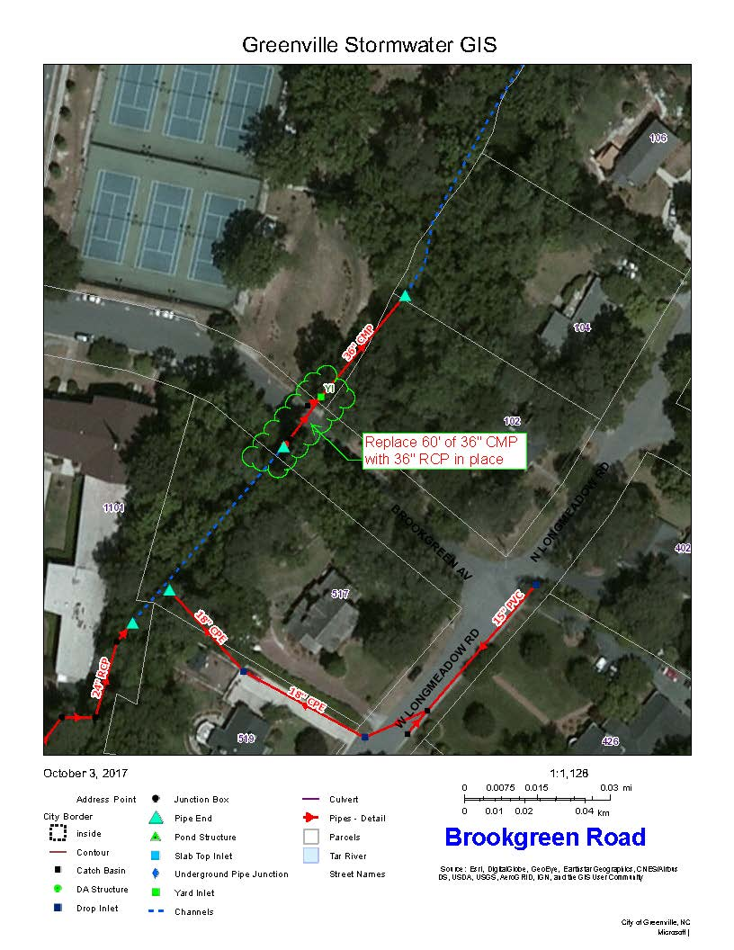
Brookgreen Road
Replace 60’ CMP with RCP in kind
City ROW
Road and headwall failure
Notes:
[Please adjust the text to be centered vertically after entering item description; turn on the static guides to help with placement.]

Slide 67
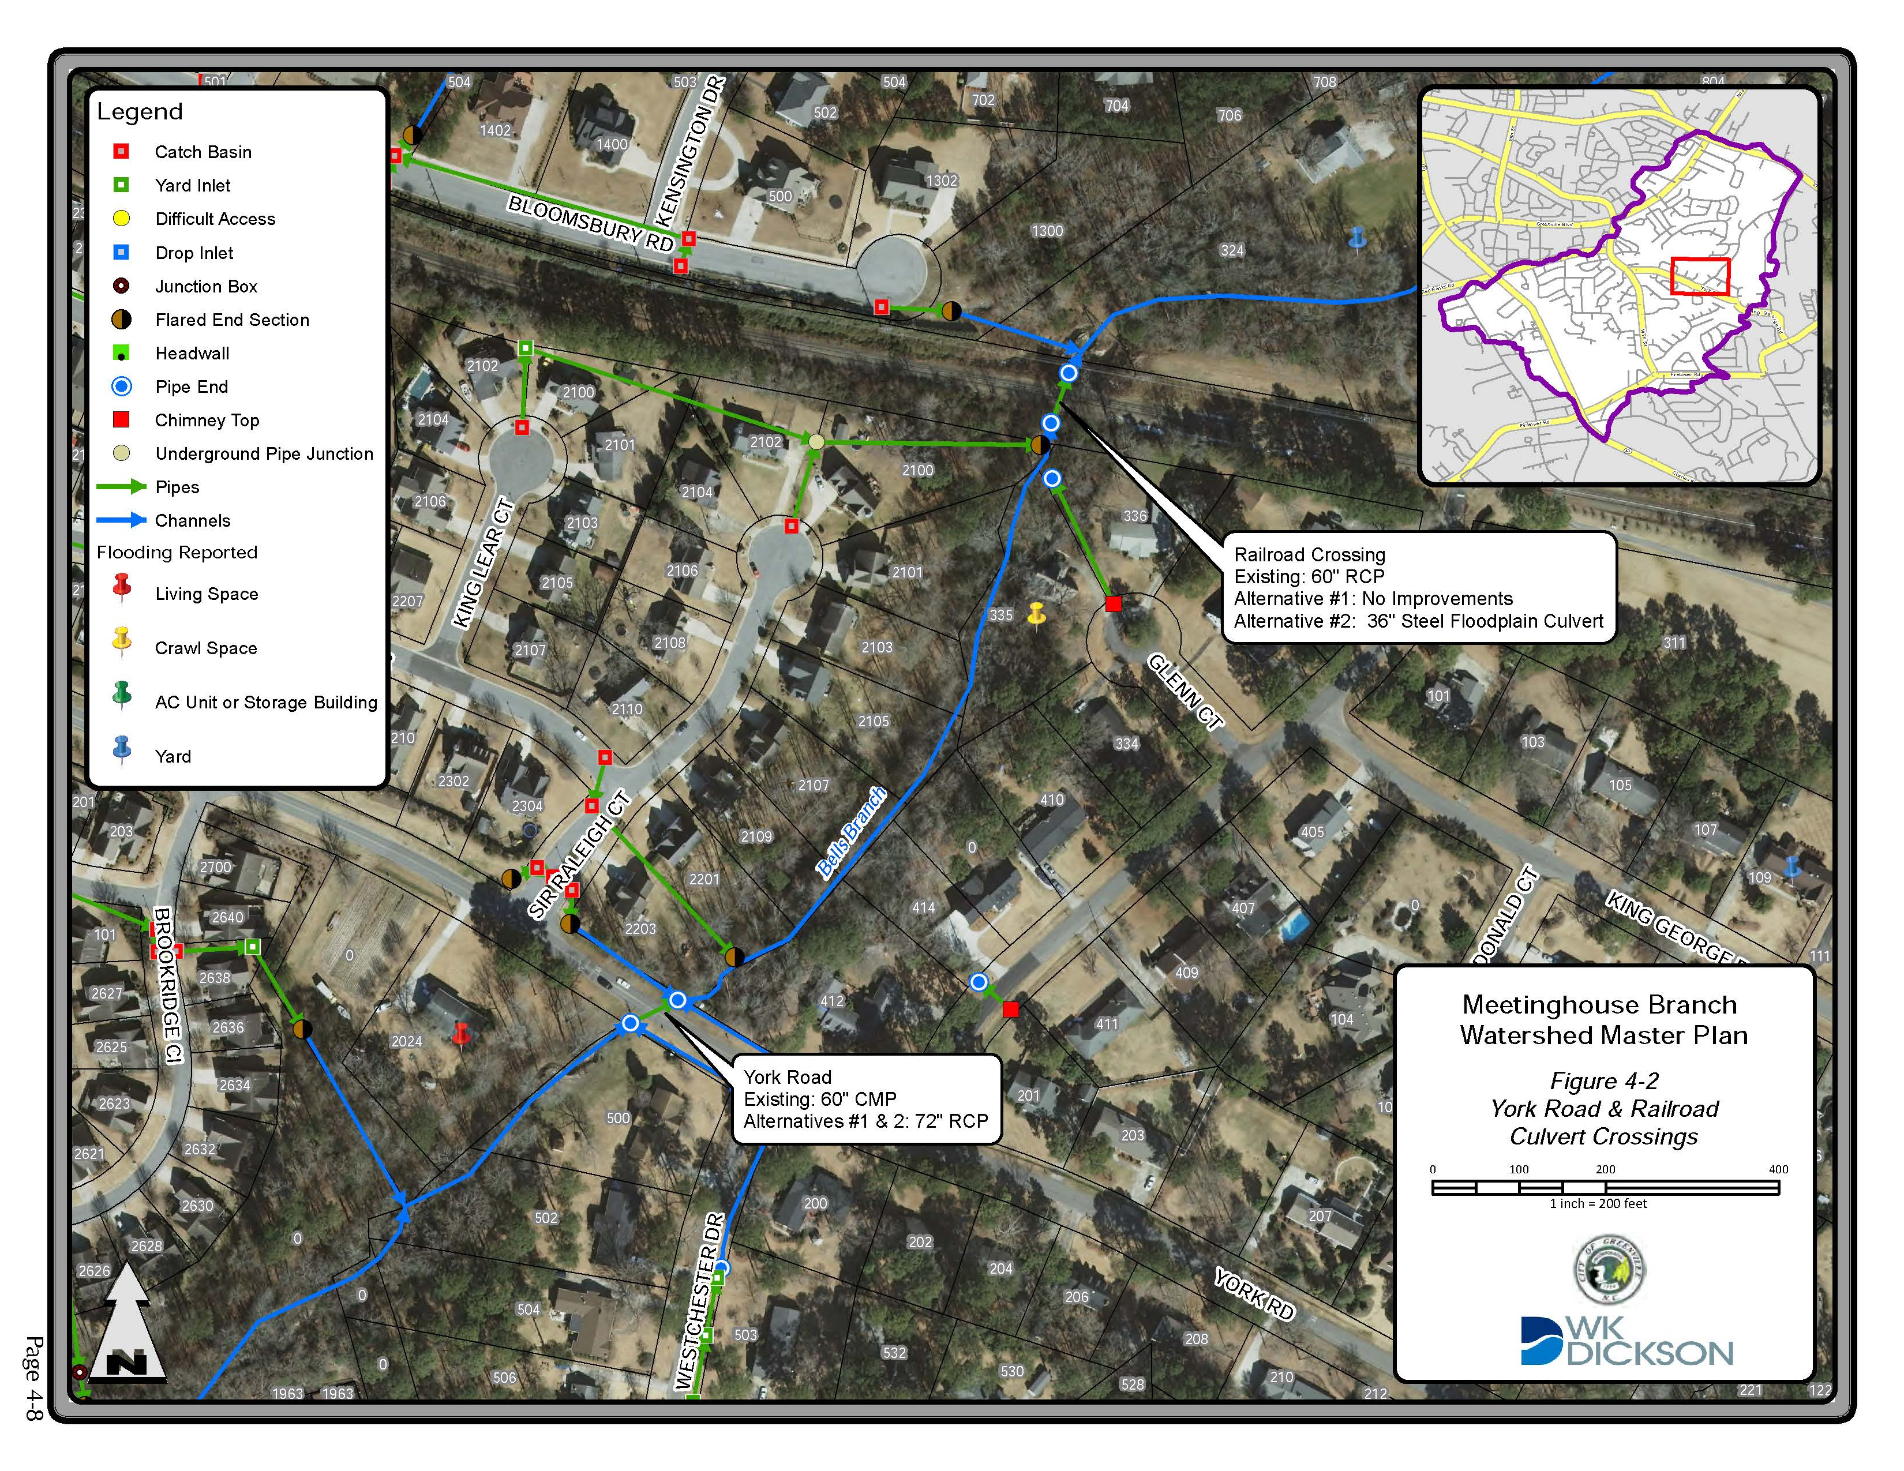
York Road
Upsize system, City ROW, Pipe end settled and displaced
Notes:
[Please adjust the text to be centered vertically after entering item description; turn on the static guides to help with placement.]

Slide 68
Questions?
Notes:
[Please adjust the text to be centered vertically after entering item description; turn on the static guides to help with placement.]

Slide 69
City Council Meeting
October 9, 2017
Notes:
[Please adjust the text to be centered vertically if title and date create line breaks; turn on the static guides to help with placement.]

