Slide 1
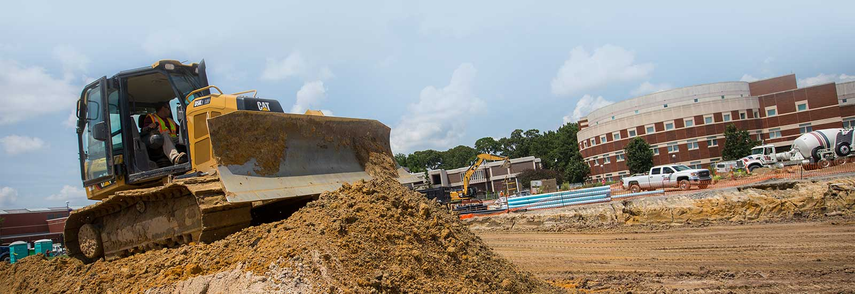

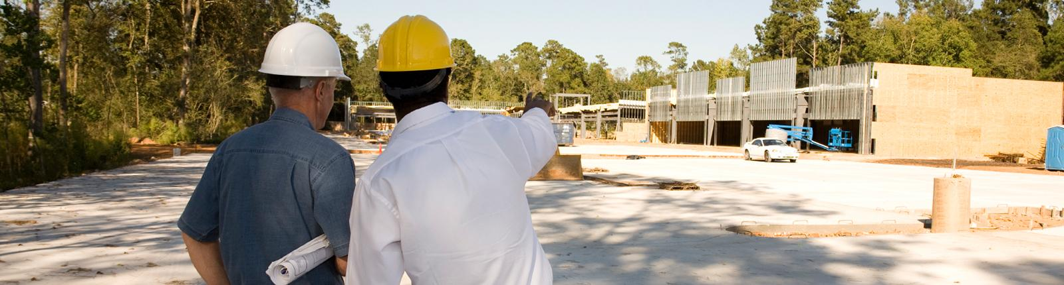
Greenville, NC Industrial Site Assessment

Slide 2

Scope
15 sites
Assessment
GIS review
Onsite evaluation/visit
Priority sites
Final report
Next steps

Slide 3
Analysis of the 15 Sites
In addition to accessibility, surrounding land uses, marketability, and curb appeal, the site assessment ranked the sites based on the following criteria:
Acreage
Floodplain
Zoning
Topography
Location of Water Bodies
Current Use
Watershed
Transportation Access
Ownership
Tax Value
Other Factors
* Sites evaluated using Creative Consulting proprietary site assessment tool called “CreativeSiteAssessment.com”:

Slide 4
General Location and Size of Sites
Site # | Total Acres
1 | 9,964.24
2 | 303.13
3 | 89.52
4 | 90.99
5 | 1,059.94
6 | 635.92
7 | 657.42
8 | 1,030.07
9 | 211.86
10 | 275.32
11 | 205.43
12 | 297.88
13 | 175.73
14 | 78.50
15 | 977.36

Slide 5
Site # 2
Greatest industrial development potential of all 15 sites.
Industries in this area include Patheon, DSM, ASMO, Fugi, and others.
Site is a good candidate for a multi-jurisdictional, or tax revenue sharing industrial park due to being in the “Recognized Industrial Area”.

Slide 6
Site # 3
2nd best site out of 15 for industrial potential.
Site is not in the Recognized Industrial Area and is annexable.

Slide 7
Site # 12
Site is near Future SW Bypass and is recommended to pursue for industrial development (ranks 3rd).
Site has the potential for rail service, but also has some potential wetlands.
Recommend analyzing this site along with Site # 13 to understand full potential.

Slide 8
Site # 13
Located near Future SW Bypass (ranks 3rd).
Recommend wetlands identification to confirm suspected water are streams and not wetlands.
Recommend analyzing this site along with Site # 12 to understand full potential.

Slide 9
Site # 4
4th best site for industrial development.
Site is fully served by all utilities.
Should do a wetlands identification on this site due to a stream bisecting the site from east to west.

Slide 10
Remaining Sites
Low Development Potential | Moderate Development Potential | High Development Potential

Slide 11
Site # 1
As County continues to develop, wastewater services will become available ($1M cost for GUC to serve).
Improvements to NC 43 & NC 33 could change the potential site access in the future.
Keep this site on the radar for the future.

Slide 12
Site # 5
Could be accessed via NC 43, but truck traffic would pass by several residential neighborhoods.
Alternate access is via NC 121
Site is better suited for residential development.
Served by Bell Arthur Water & sewer is not available.

Slide 13
Site # 6
Do not recommend pursuing this site for industrial development.
Highest potential for site is residential.
Truck access would too close to existing residential neighborhoods.

Slide 14
Site # 7
Served by Bell Arthur water.
Uncertainty due to ownership plans for site takes this out of consideration.

Slide 15
Site # 8
Recommend not pursing site (remote & rural)
GUC does not serve this site for electricity, water, or wastewater.
Access road is not up to industrial standards.

Slide 16
Sites # 9 & 10
Sites were included due to rail access and proximity to the future interstate.
Recommend not pursuing these sites due to water and sewer not being available.
Not served by GUC water and sewer.
Potential service from Farmville or Bell Arthur Water.

Slide 17
Site # 11
Recommend not pursuing this site at this time.
Site not served by GUC water and sewer.
Bell Arthur Water & no sewer service.
Possible future rail-served site when utilities are closer and become feasible.

Slide 18
Site # 14
Site has all utilities, but is best suited for residential and commercial development.

Slide 19
Site # 15
Site eliminated from consideration because it is actively being farmed.
Served by Bell Arthur water.
No wastewater.

Slide 20
Recommended Sites
Site # 2
  303.13 acres
  Close to Patheon, DSM, ASMO, Fugi, and others.
Site # 3
  89.52 acres
  Site contains all utilities and is annexable.
Site #’s 12 & 13
  Site 12: 297.88 acres
  Site 13: 175.73 acres
  Close to Future SW Bypass
Site # 4
  90.99 acres
  Fully served by utilities and easily accessed by US 264 and NC 11.

Slide 21


Next Steps
#1
Confirm sales price and availability
Marketing
Control of Property
Inventory and complete due diligence
Development

Slide 22
Questions?

Slide 23

Crystal Morphis
CEcD, LEED Green Associate
www.creativeedc.com
www.creativesiteassessment.com
www.creativecec.com
www.certifiedindustrialbuilding.com

