Slide 1
2024 Non-Profit Funding Workshop
2025 CDBG Funds
Isabella Sardina
Program Specialist
City of Greenville, NC
NBS, Community Development Division

Slide 2
Workshop Agenda
Funds available
CDBG Overview
CDBG & Non-Profits (Sub-recipient)
The Application Process
The Approval Process
Agency Monitoring and Reporting
Questions and Answers

Slide 3
Funds Available
Public Service - $150,000
Notes:
Approximately… worth of CDBG funds are available

Slide 4
Housing and Community Development Act 1974:
Decent housing
Suitable living environment
Expanded economic opportunity
Principally for low-moderate income individuals
Primary Objective: Development of viable urban communities by providing…
Community
Development
Block
Grant
Notes:
Housing and Community Development Act (HCDA) of 1974 created the…

Slide 5
CDBG & Greenville
Greenville has been an entitled CDBG recipient since 1994
CDBG is a formula grant – the amount awarded to the city is based off of a formula that takes several factors into consideration.
Notes:
For the Entitlement Program, there are two formulas: "A" and "B". HUD calculates the amount of funds
that each entitlement grantee would receive under each of the two formulas.
Formula A calculates funds to a jurisdiction based on its metropolitan area’s share of 3 factors across all
US metropolitan areas. The factors are:
1. population, weighted at 25 percent;
2. people in poverty, weighted at 50 percent; and
3. overcrowded units, weighted at 25 percent
Formula B also calculates funds to a jurisdiction based on its metropolitan area’s share of 3 factors
across all US metropolitan areas, but the factors are somewhat different. The Formula B factors are:
1. population growth lag since 1960, weighted at 20 percent;
2. people in poverty, weighted at 30 percent; and
3. pre-1940 housing units, weighted at 50 percent.
After HUD runs the calculations using the two formulas, it allocates the grantee the larger amount of the
two. However, because HUD uses the larger amount, when it adds all of the grantees’ allocations
together the total is higher than the amount of CDBG funding available for the Entitlement program. So
HUD must recalculate the figures using a pro-rata reduction to reduce the total to the funding level for
the Entitlement Program.

Slide 6
Governing Entity: HUD
Grant: CDBG
Recipient: City of Greenville
Subrecpient / Non-Profit
Subrecpient / Non-Profit
Subrecpient / Non-Profit
Subrecpient / Non-Profit

Slide 7
CDBG Overview
CDBG Objective
Preservation and development of viable communities by providing decent housing, a suitable living environment, and economic development opportunities, public services and public facility improvements principally for low- and moderate-income persons.

Slide 8
CDBG Overview
CDBG Overview
Communities develop their own programs and funding priorities based on local needs.
HUD has established guidelines to define the types of projects and activities that may be undertaken and to ensure each project or activity meets one of the national objectives of the CDBG Program.

Slide 9
CDBG Overview
CDBG Three National Objectives
Benefit low-moderate income persons either individually or area-wide, or activities that benefit special populations.
Aid in the prevention or elimination of slums and blight.
Meet urgent need.

Slide 10
CDBG Overview
Categories of Eligible Activities
  Administration
  Housing Rehabilitation
  Public Facility Improvement
  Public Services
  Acquisition
  Clearance/Demolition
  Infrastructure Improvement

Slide 11
CDBG Overview
Federal Rules & Regulations
A minimum of 70% of the annual grant must support activities that benefit low-to-moderate-income (LMI) persons.
Income must be documented and verified for each client or household. (some exceptions)
A maximum of 15% of the total annual grant can be used for public service activities.
A maximum of 20% of the total annual grant can be used for administrative activities.
Administrative, Public Service, and Public Facility project records must be maintained for 5 years from the completion of the project.

Slide 12
CDBG Overview
Religious Activities
Funds generally may not be used for religious activities or provided to primarily religious entities for activities.
Funds may be used for eligible public services to be provided through a religious entity, provided that the entity enters into an agreement with the City stating that it will not discriminate on the basis of religion, and it will not provide any sort of religious services or activities as part of the project/service.

Slide 13
CDBG Overview
Documentation & Record Keeping
  Monthly / Quarterly / Annual reports with supporting
  documentation are required, as well as annual monitoring
  visit(s) to ensure compliance with appropriate rules
  and regulations.
  Eligibility
  National objective
  Citizen participation
  Fair housing
  Financial
  Other requirements

Slide 14
CDBG Overview
CDBG Overview
  HUD Required Reports:
  Consolidated Plan (CP)
  Annual Action Plan (AAP)
  Consolidated Annual Performance & Evaluation Report
  (CAPER)
  The City encourages all residents to participate in the planning and Development of the CP & AAP.

Slide 15
Non-profits

Slide 16
CDBG & Non-Profits
The City seeks to provide funding for projects and services that are innovative while meeting the national objectives as identified by the CDBG Program:
    Housing Counseling
    Services that benefit low-moderate income households
    Homeless or special needs populations
    Job Training
    Youth Development

Slide 17
Choosing Projects or Services
Eligible Activities
Youth services (mentoring, after school programs)
Services for senior citizens
Employment services (job training)
Financial - Homebuyer Education / Counseling
Services for the homeless
Substance abuse services (counseling / treatment)
Crime prevention
Recreational services

Slide 18
Choosing Projects or Services
Eligible Activities (Cont.)
CDBG funds may be used to pay for labor, supplies and material to maintain the portion of a facility in which the public service is located. This includes the purchase or lease of equipment & other property needed for the public service.
To utilize CDBG funds the service must:
    Be a new service, or an increase in the level of an existing
    service which is being provided by the grantee.
    Service at least 70% low income; or provide service to a
    low income neighborhood in Greenville.

Slide 19
Choosing Projects or Services
Ineligible Activities
There are certain expenses or projects that nonprofits will seek funding for which are ineligible expenses for CDBG funds. (Please note that this is not an all-inclusive list).

Slide 20
Ineligible Activities
Organizations Administrative Costs
  Salaries and Benefits
  Rent, Utilities, Telephone
Political Activities
Income Payments to Clients (food, clothing, rent, mortgage, etc.)
Activities outside the City of Greenville Corporate Limits
Acquisition of Real Property for a Religious Facility of improvement to a religious facility or other projects that are for a religious nature / purpose.
Any organization or service not benefiting Low-moderate income households.

Slide 21
Application Process

Slide 22

Application Process
Required Documentation
Application from the Community Development Division
501c(3) Status
Articles of Incorporation
Current Audit Documentation
Board Member Lists
Program Information & Explanation
Valid lease (during funding year)

Slide 23
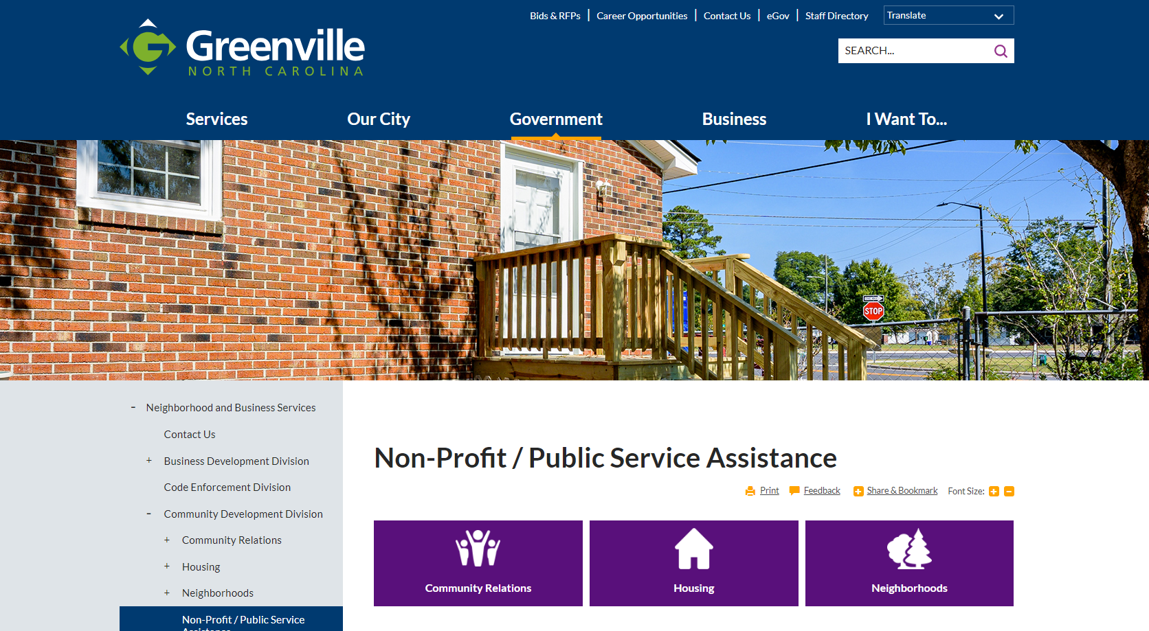
Application Process
Application from the CDD Division

Slide 24
Application Process
501c(3) Status
501c(3) status - copy of your LEGAL status from the IRS as an established non-profit.
You must be recognized legally as a non-profit by Charter or Articles of Incorporation.
You must have at least two years experience as a non-profit in the area for which you are requesting funding.

Slide 25
Application Process
Current Audit Documentation
A copy must be provided for the 2021 & 2022 calendar years. (two most recent)
The audits must be clean and free of findings.
The audit must have been completed be a Certified Public Accountant.

Slide 26

Application Process
Board Members List
Must Include…
Complete list of all board members with home mailing addresses and phone numbers.
Total number of required board members.
Affiliations (COG, Retired, ECU, etc.)
Length of Time on Board

Slide 27
Application Process
Board Members: Regulations
Conflict of Interest: Board members must not be related to anyone in the decision-making process.(CD Division Staff, COG Staff, AHLC, City Council, HUD, etc.)
Board members must not be employed by the City of Greenville or HUD.
  Exception: City of Greenville divisions not a part of the review or decision process.

Slide 28

Application Process
Program Information
Organization Information
Program Types and Descriptions
Any Additional Information
Funding Sources
Staff Listing and Staff Resumes

Slide 29
Application Process
Application Do’s & Don’ts
Be innovative
  We’re looking for unique and innovative projects
  If your project has been funded before - how can you increase
  your level of service
Funds are limited so be realistic in your request
  Is it a project you can complete within 12 months?
  Do you have other funds available?
    CDBG funds are “gap” funds. We cannot fund a project 100%
Don’t forget the Basics
  Complete ALL questions in the application (use N/A)
  Use the application checklist to verify all requested information
  has been provided

Slide 30
Application Process
Application Due Date
Applications must be in the Neighborhood & Business Services Department
CDD Division office by 12:00 PM on Friday, December 27, 2024.
Applications received after the deadline for any reason will
NOT be accepted.
Must provide one (1) signed original & one (1) copy,
to include the application and all attachments.
Each must be in a separate bound folder or notebook.

Slide 31
Approval Process

Slide 32
Internal Process
Grant applications go through a four-step approval process:
Staff Review (Non-compliant organizations are notified.)
Affordable Housing Loan Committee reviews the requests and makes funding recommendations to City Council.(Compliant organizations present projects to the AHLC.)
City Council reviews the Committee’s recommendation and may adopt or change the funding allocations.
The Council’s funding decision is then sent to HUD as part of the City of Greenville’s Annual Action Plan for HUD approval or denial.

Slide 33
Internal Process
Organizations notified of awards
Agreements signed & work begins
Things to keep in mind

Slide 34
Presentations to the Affordable Housing Loan Committee (AHLC)
    Prepare a 10-minute presentation for the AHLC
      Overview of your program
      Overview of your project / service and why it is needed
    Come prepared for a brief question & answer period with the AHLC about your project/service

Slide 35
AHLC Proposal Scoring
Need for the service 30
Internal & External Consistency 10
Leveraging 15
Self Sufficiency 10
Innovation & Partnerships 10
Financial Feasibility 5
Performance 10
Direct Benefit 10
New/Previous Applicant 10
        Total points 110

Slide 36
Agency Background
Prior work experience with CDBG and other grant funds
Adequate staff
Key staff experience/capability
Agency capacity
Debarment
Insurance

Slide 37
Target Population
Service area identified (Greenville City Limits)
Any special attention to target population
Are gaps and barriers identified?

Slide 38
Service Need
Is the need adequately described?
Will the project address program & service gaps?
Will the project improve the quality of life?
Does the applicant indicate outcomes?

Slide 39
Approach to Service/Work Plan
Short term goals
Does the applicant define goals?
Is the process adequately described?
Outcomes and success measurable?

Slide 40
Coordination & Collaboration
What National Objective is being met?
Any efforts to coordinate and collaborate with other agencies?
Any MOU or agreements in application? (MOU = Memorandum of Understanding)

Slide 41
Current Financial &
Other Resources
Budget included on forms.
Is budget focused on services not admin?
Is the budget reasonable?
At least 85% of funds must be utilized directly for your program, project, or service.

Slide 42
Projected Timeline
January 2025 -----------Applications reviewed by CDD Staff
End of Jan 2025 --------Organizations notified (application status)
Organizations notified of Affordable Housing
Loan Committee (AHLC) presentation
February 2025 ---------Organizations present projects/answer questions (AHLC)
April 2025 --------------City Council reviews the AHLC recommendation and may adopt or change the funding allocations.

Slide 43
Projected Timeline
May 2025 ------------- The Council’s funding decision is then sent to HUD as part of the City of Greenville’s Annual Action Plan for their approval.
June 2025-------------Organizations Notified of Awards
July 2025--------------Contracts signed / Work Begins

Slide 44
Working With CDBG Grant Funds
Funds are distributed by reimbursement only.
Please do not begin ANY work until your contract has been signed (Greenville City Manager) and your scope of work approved.
We cannot and will not reimburse for any expenses incurred prior to the date of the Greenville City Manager’s signature.
Provide monthly reports by the 15th of each month for compliance.

Slide 45
Working With CDBG Grant Funds
Submit the Monthly Request for expended funds by the 15th of each month for reimbursement.
Funds are to be expended within the 12-month contract period.
All funded non-profits will be required to submit quarterly beneficiary data reports.
A cumulative final report will be required at the end of the funding year.

Slide 46
Quarterly Report Timeline
July – September Due on: October 15th
October – December Due on: January 15th
January – March Due on: April 15th
April – June Due on: July 15th

Slide 47
Monitoring
and Reporting

Slide 48
Monitoring and Reporting
What is the purpose of a sub-recipient monitoring?
  It’s a HUD Requirement.
    Sub-recipient monitoring is a key part of the CDBG program. The City bears the responsibility to ensure that Sub-recipients follow federal regulations, conduct the projects / services and accomplish the goals as established in the sub-recipient agreement.
  Monitoring also provides opportunities for both the City and the Sub-recipients to identify issues that may hinder efforts to successfully accomplish the goals and address these issues in a timely manner.
  Monitoring is also used by the City as a way to identify sub-recipient needs and provide technical assistance if necessary.

Slide 49
Items to have available
Administrative files
Client/project files
Audit/financials
Board minutes
File cabinet
Insurance certificate
Policies and procedure manual
Knowledgeable Staff
IRS forms
State (NC) forms

Slide 50
What happens during a monitoring visit?
Progress of Project/Service reviewed
Client Files reviewed for compliance
Administrative Files reviewed
Monthly reports are reviewed
Site/project visit
Staff & Sub-recipients will have the opportunity to discuss any concerns or issues

Slide 51
Use of Monthly Reports for Monitoring:
Monthly reports are used to track progress of your project / service.
  Reports are designed to capture information needed for reporting purposes by the City.
  Reporting forms will be provided by the City and are due by the 15th of each month.
Monthly reports also give Subrecipients an opportunity to “shine” by sharing with the City all the activities and events happening within their agency.
Beneficiary Data reports collected quarterly and used for documentation into HUD’s Integrated Disbursement Management System (IDIS).

Slide 52
Key Reminders for Existing and Future Subrecipients
Try to allocate your funds to each line item as accurately as possible from the start.
    You cannot reallocate more than 10% of your TOTAL award throughout the entire program year – unless AHLC approves.
Please turn in your monthly reimbursement requests on time and double check all numbers.

Slide 53
Questions?

Slide 54
Staff Contact Information
Isabella D. Sardina, Program Specialist
(252) 329-4295 office
(252) 329-4631 fax
isardina@greenvillenc.gov

