Slide 1
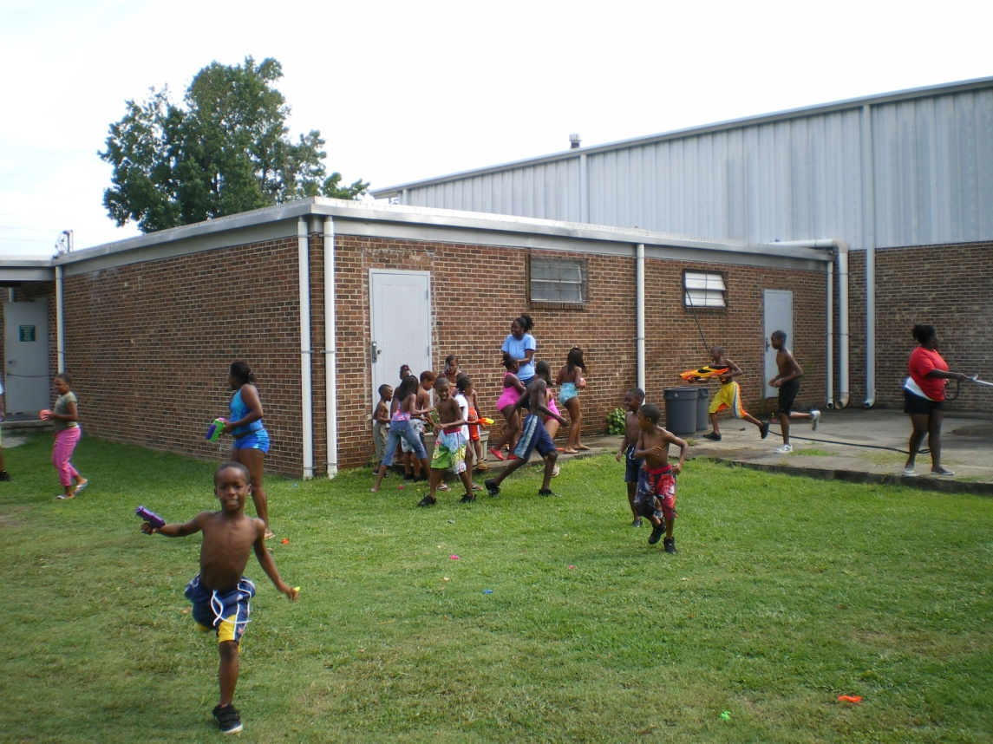
South Greenville Recreation Center and
Park Master Plan

Slide 2
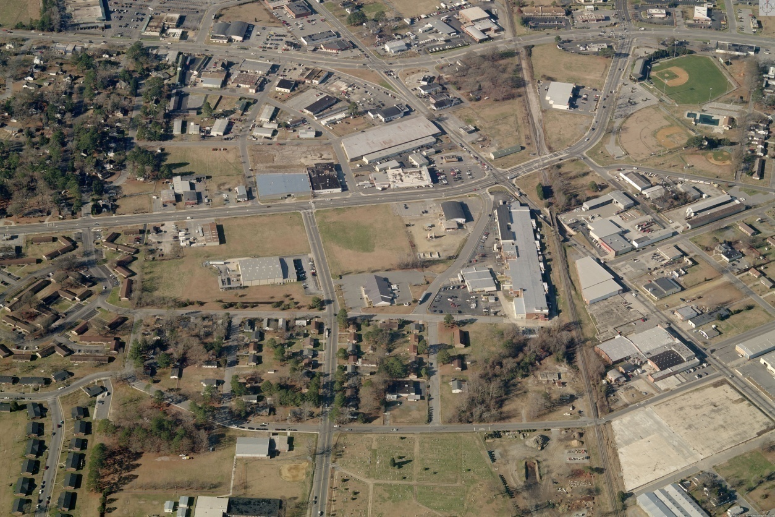
South Greenville Park - Classification
Neighborhood Park by Park Service Standards
- Typically 5-12 Acres
- Sports Fields
- Playground

Slide 3
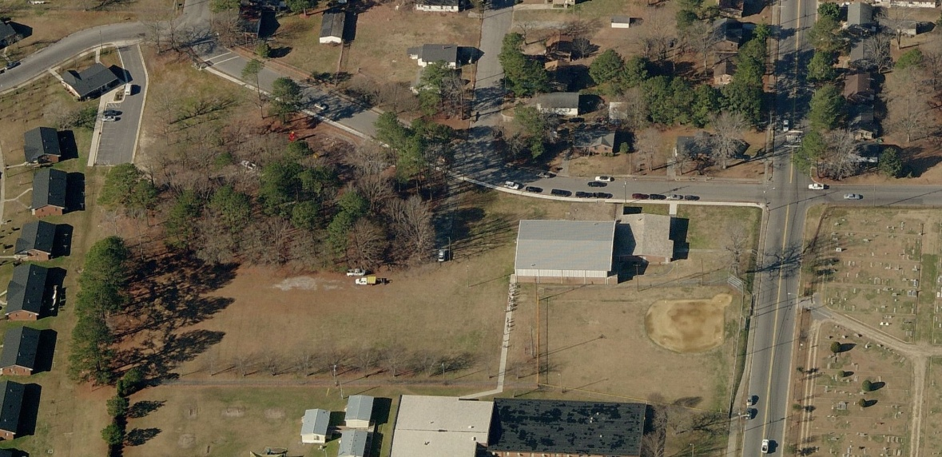
Park Classification - continued
Park sits on 12 acres
Park Amenities:
- 14,744 sq. ft. Recreation Center
- Little League Baseball Field
- Multi-purpose Field
- New Playground
- Picnic Shelter

Slide 4
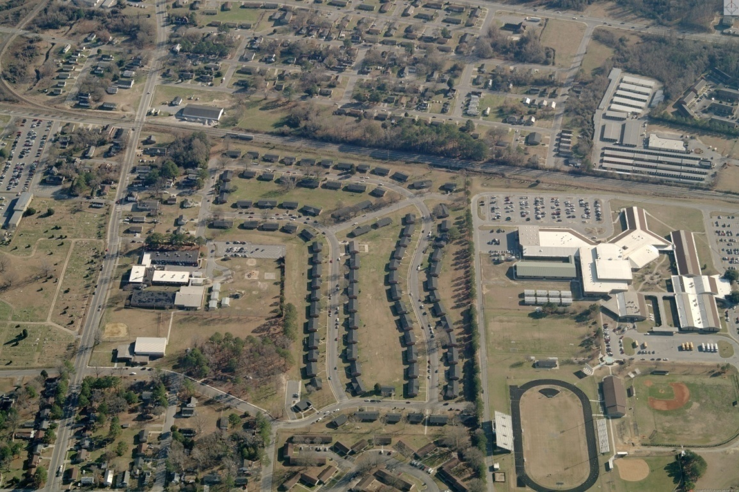
Park Service Area
Serve Neighborhoods in South Greenville
Pitt County Schools
Police Athletic League (PAL) After School Program

Slide 5
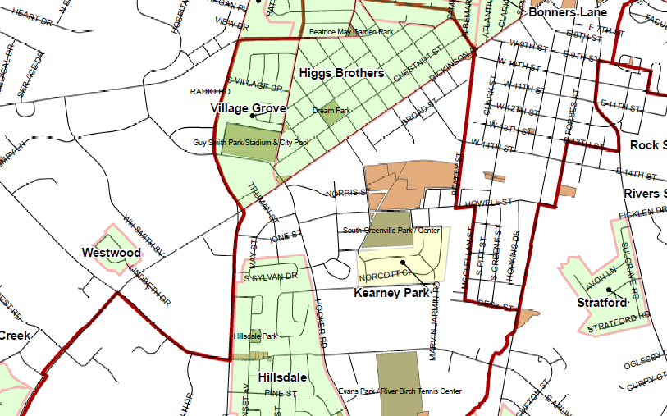
Service Area – 1 Mile Radius
North - Village Grove and Higgs Brothers
South - Kearney Park (Public Housing)

Slide 6
Service Area – 1 Mile Radius
West – Westwood and Hillsdale
East – South Greenville Elementary & Residential
Notes:
Recreation center is the closest center for several other neighborhoods in District 1

Slide 7
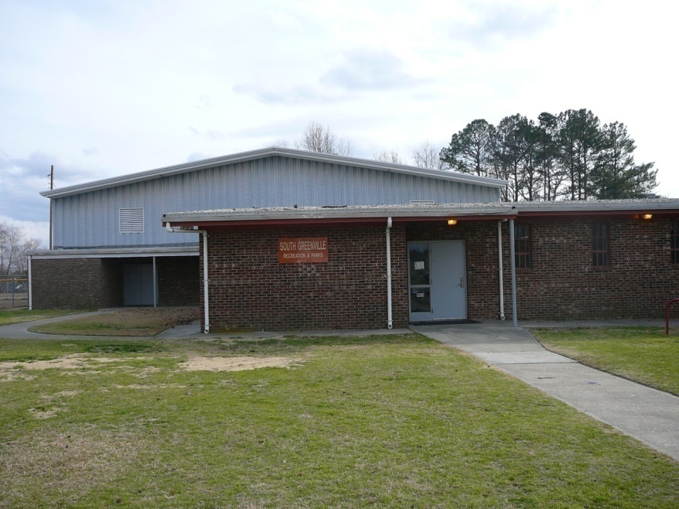
History
Original Facility Built in 1949
Building Renovation/ Expansion in 1957
Gymnasium
Fitness Room
2 Offices
Restrooms
Multi-purpose Room
Computer Lab

Slide 8
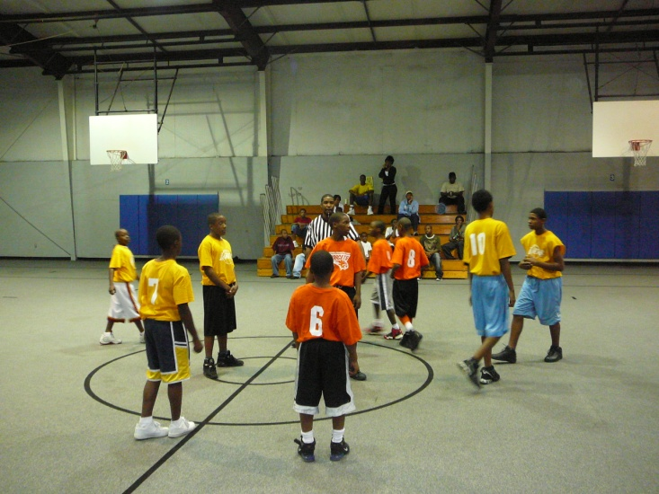
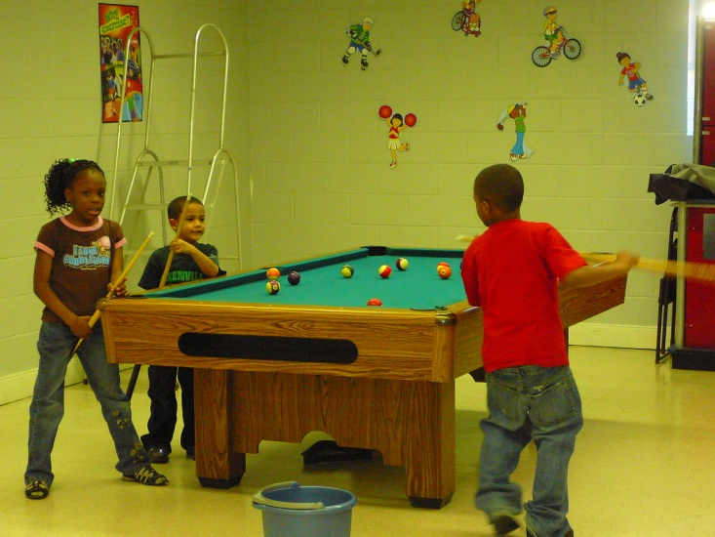
Programs
Jr. NBA / WNBA League
Flag Football League
Jackie Robinson Little League Baseball
Girl Scouts
PAL After School Program

Slide 9
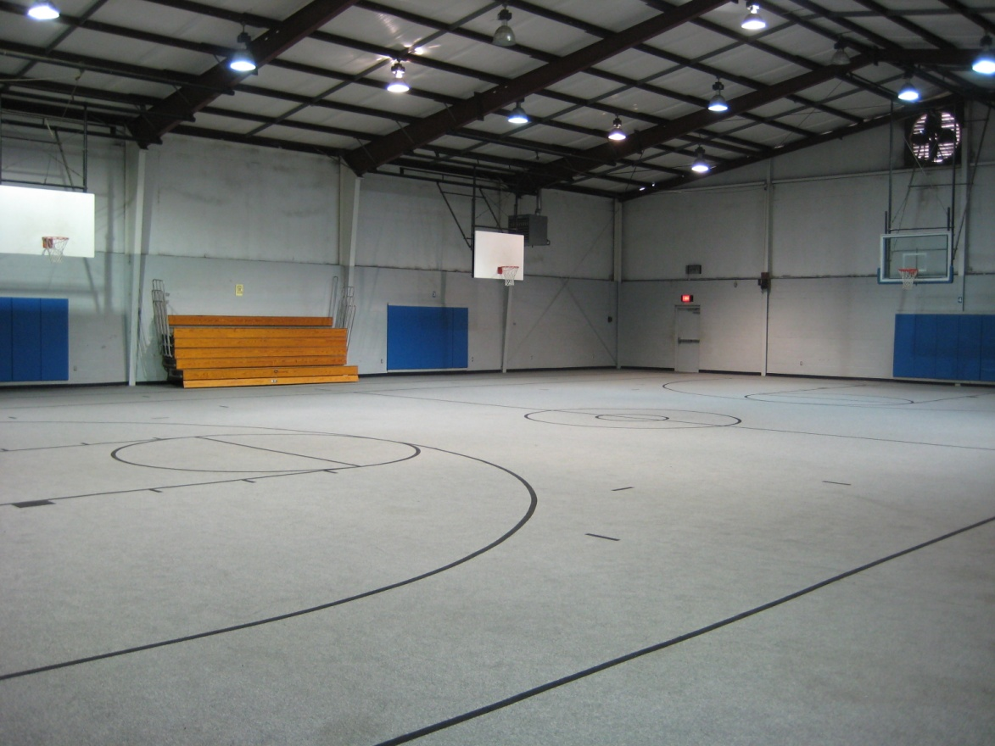
What Are The Deficiencies?
What Are The Needs?

Slide 10
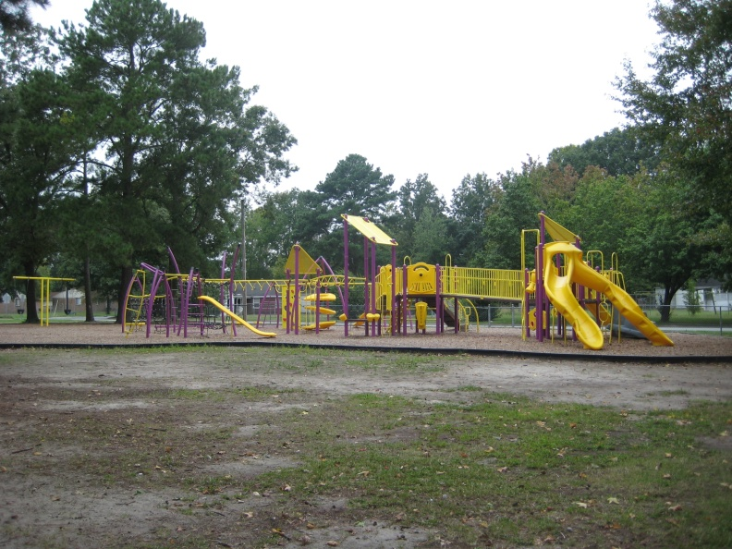
Major Renovations are Needed ! !
The has been no major renovation to the South Greenville Recreation Center since 1957
New Playground was installed with CIP Funding in 2009

Slide 11
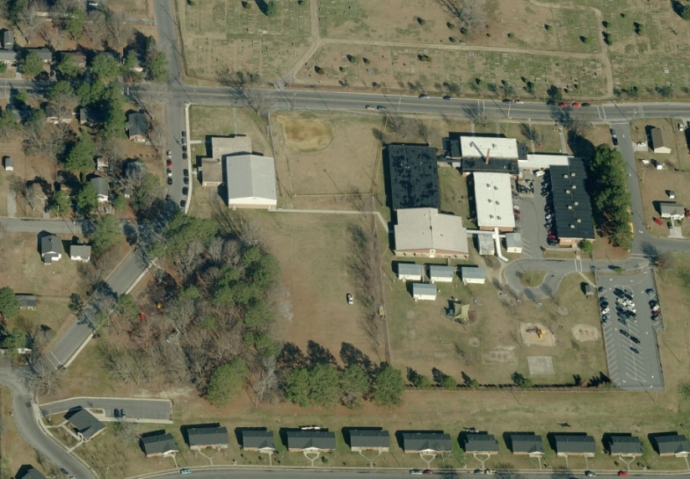
Capital Needs – 2008-2013
Staff Request $5,700,000 in 2008
- Demolition
- Construction
- Architectural Fees
Anticipated CIP Funding in 2011 - 2013
Notes:
Finance sets priorities and voted on by City Council

Slide 12
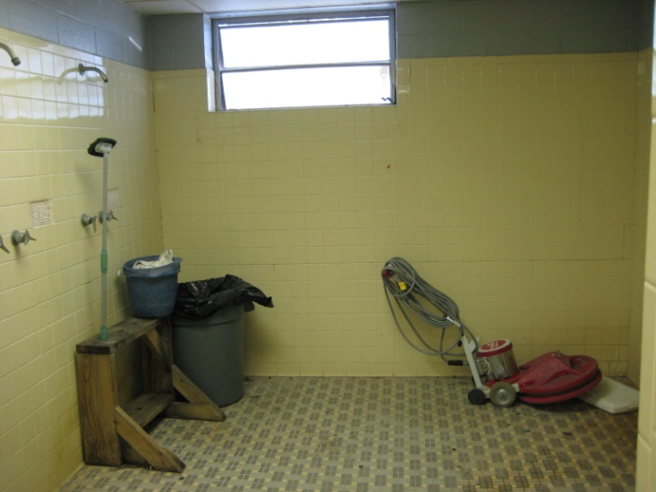
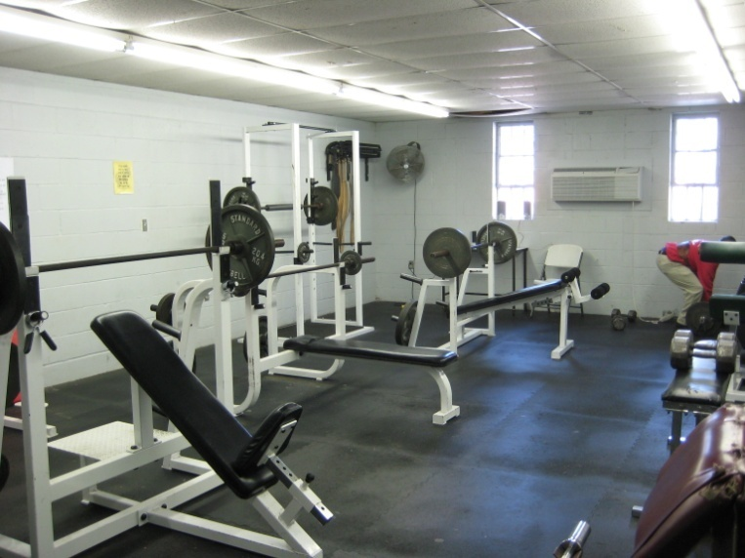
Deficiencies
Facility outdated
Differed infrastructure and maintenance
Space not adequate for programs
Restrooms /dressing rooms are not
ADA compliant

Slide 13
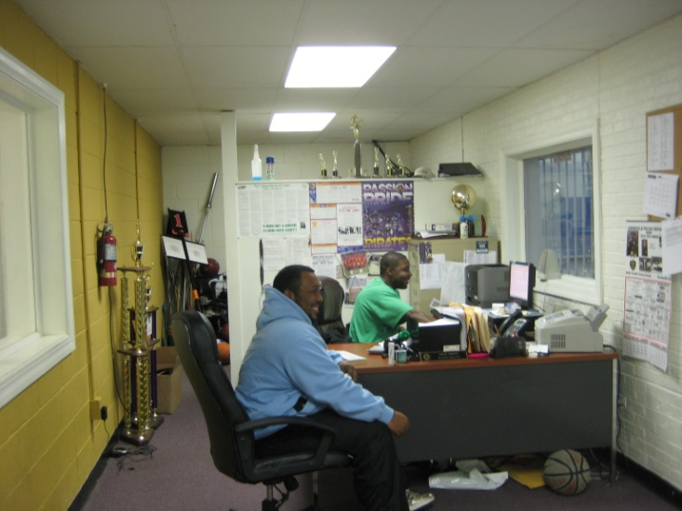
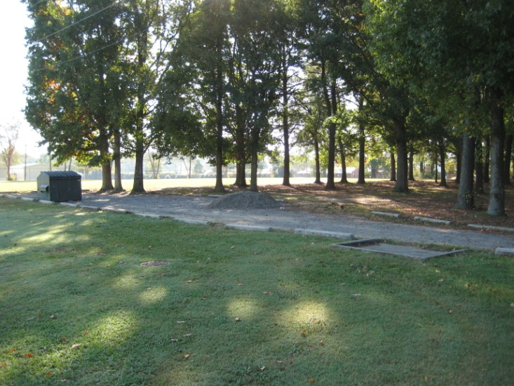
Deficiencies
Lacks adequate office space for staff
Need space for meetings
Site lacks site amenities:
- bleachers, signage, goal posts
Parking areas do not meet ADA standards

Slide 14
Capital Needs Assessment (CNA)
Category options: Trails (T); Park Renovations (PR); Building Renovations (BR); New Buildings (NB); New Parks (NP); Existing Park Expansions (EPE); ADA Compliance (ADA); Health & Safety (HS).
Priority Ranking options: High, Medium, Low
FACILITY: | South Greenville Park & Center
ASSET | CATEGORIES | WORK DESCRIPTION | PRIORITY RANKING | COST ESTIMATE
Office & Programming space | ADA, BR, HS | Current program space is outdated, undersized (which severely limits program options), non-compliant with ADA, unable to be monitored by staff due to very poor configuration, and unsafe for users as a result. This building section should be demolished and a new, modern recreation center built in its place. |  | $3,117,528
Gymnasium | ADA, BR | Gym structure is sound but needs significant renovation. Renovation includes roof repair or replacement (depending on condition assessment results), floor replacement, new wall finishings throughout (upper & lower sections), insulation evaluation (likely sub-standard or wet from leaks), installation of energy efficient lighting, gym air conditioning, installation of 2 sets of roll out bleachers, & gym-style water fountains with large basin. Create ADA compliant access at all entrances. |  | $1,346,859

Slide 15
Capital Needs Assessment
Category options: Trails (T); Park Renovations (PR); Building Renovations (BR); New Buildings (NB); New Parks (NP); Existing Park Expansions (EPE); ADA Compliance (ADA); Health & Safety (HS).
Priority Ranking options: High, Medium, Low
FACILITY: | South Greenville Park & Center
ASSET | CATEGORIES | WORK DESCRIPTION | PRIORITY RANKING | COST ESTIMATE
Parking lot | ADA, PR, HS | Install appropriate sized parking lot with security lighting for center users. Create ADA spaces as required. |  | $57,130
Football/soccer multi-use field | PR, HS | Install bleachers, goal posts, & improve field surface to make field safe & appropriate to use for as a multi-purpose field. |  | $16,000
sprayground | PR | Install a sprayground adjacent to the playground site to provide recreation opportunities for neighborhood children. |  | $300,000
Park; general | PR, ADA | Install ADA access to the picnic shelter & other park amenities. Install new fence adjacent to the playground. |  | $15,000

Slide 16
CNA Summary:
HARD COST
Recreation Center Renovations and Park Renovations $4,858,130
SOFT COST
Architectural and Engineering Fees (7% of Construction) $340,069
Owner’s Contingency (testing, permits, printing, advertising 10%) $485,813
GRAND TOTAL $5, 684, 012

Slide 17
Next Steps
Submit Capital Improvement Request in October 2009
Complete Programming for park and recreation center & Master Plan
Request funds for Design Phase (Architect & Engineer)
Complete Design Phase
Construction Phase

Slide 18
Comments &
Questions

